Slide 1
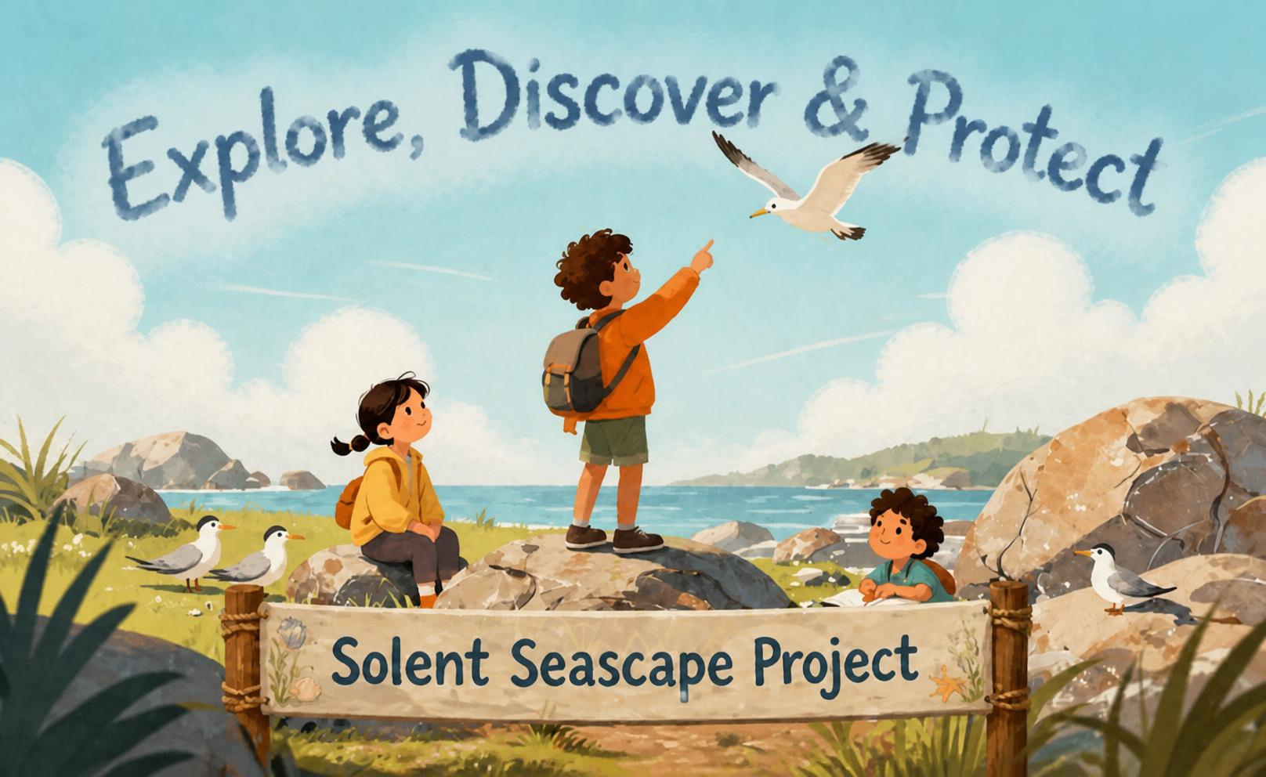
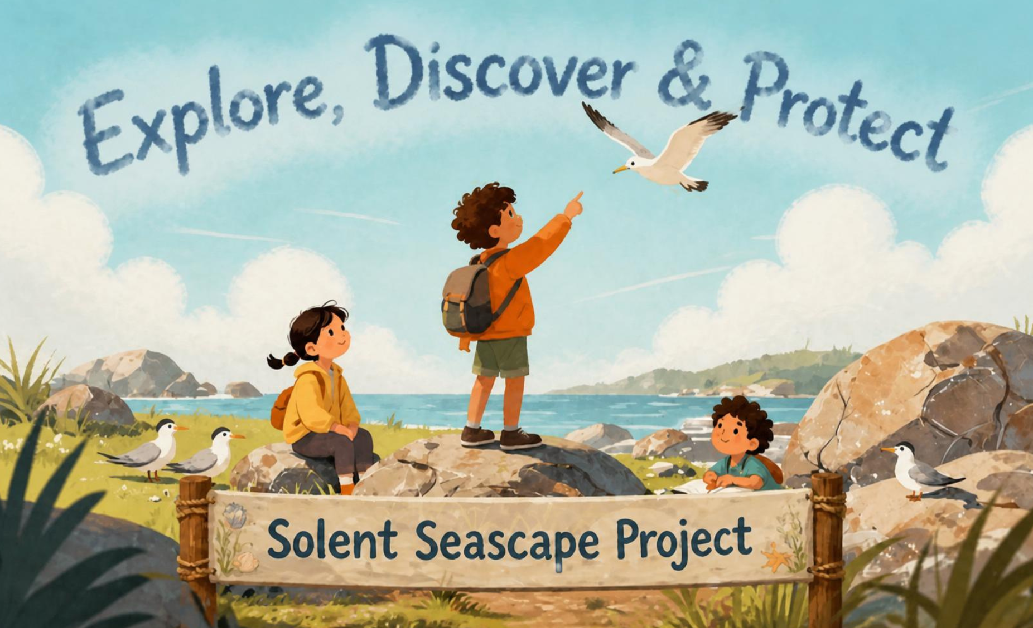


Become Habitat Detectives: The Solent Under Threat
Time: 60 minutes​
Level: KS2
Subjects: Science; Geography and Working Scientifically
Explore four Solent habitats, meet the animals that live there and
discover how we can
protect them.
Notes:
The Solent is a stretch of water on the South Coast of England between Portsmouth and the Isle of Weight, where Blue Marine are working to protect.

Slide 2
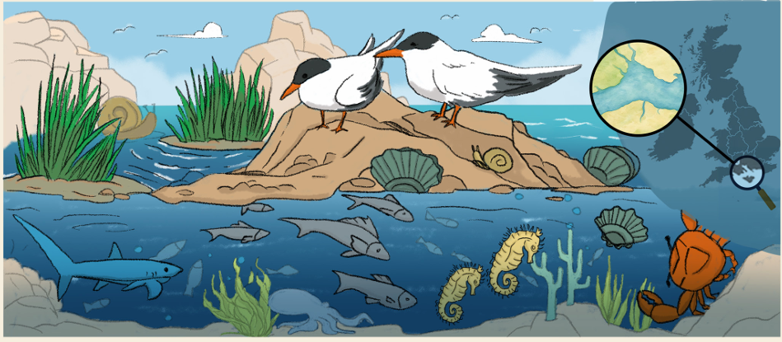

Learning Intentions
The ocean is home to a variety of different marine habitats that are all important for wildlife and people.
Success criteria:
1. Describe what a habitat is and explain why they are important for animals and people.
2. Identify different marine habitats found in the Solent.
3. Investigate the threats damaging marine habitats and the possible consequences.
4. Suggest ways people can protect and restore marine habitats.
5. Share findings!

Slide 3

Curriculum links (KS2)
Science | Science
Living Things and Their Habitats | Recognise that living things live in habitats to which they are suited
Living Things and Their Habitats | Describe how habitats provide animals and plants with what they need to survive
Living Things and Their Habitats | Identify how environments can change and how this can affect living things
Living Things and Their Habitats | Construct and interpret simple food chains
Working Scientifically | Working Scientifically
Students will observe and analyse evidence | Students will observe and analyse evidence
Students will group and sort information | Students will group and sort information
Students will make simple conclusions | Students will make simple conclusions
Students will communicate findings | Students will communicate findings
Students will discuss environmental problems and solutions | Students will discuss environmental problems and solutions
Geography | Geography
Human and Physical geography | Coastal environments and habitats
Human and Physical geography | Human impacts on environments
Human and Physical geography | Caring for and protecting environments
Human and Physical geography | Sustainability and conservation

Slide 4
Lesson overview
Section | Time | Summary | Additional Resources
Warm up Who Lives here | 2-3 mins | Short quiz where young people pair the habitat to the species . | Optional pens and paper
Learn What's a habitat and ‘mission brief’ | 2-3 mins | Introduce the meaning of a habitat and explain that children will become “Habitat Detectives” investigating habitats under threat in the Solent. Introduce the four habitats: seagrass meadows, oyster reefs, saltmarsh, and seabird nesting habitats.
Investigate Identify: causes, animals in danger, consequences and potential actions. | 20 mins | Students work in groups using evidence packs to investigate one habitat. They examine healthy and damaged habitat images, identify which animals rely on the habitat, decide what caused the damage, and explore what might happen if the habitat disappears. Students will then discuss actions that could prevent destruction of their habitat. Groups complete a simple detective report summarising their findings and ideas for helping the habitat recover. | One “Evidence Pack” per group containing: Animal/species cards What's the problem cards Case report sheet Pens/highlighters
Report Back Report to the Chief of Marine Conservation | 15 mins | Each group presents their investigation findings to the class. Presentations should include: Which habitat was investigated? Which animals were affected? What caused the damage? What could happen if nothing changes? How could we help protect the habitat? | One “Evidence Pack” per group containing: Animal/species cards Threat/culprit cards Case report sheet Pens/highlighters
Poster Summary | 10 mins | Young people either individually or in small groups to create signs to help raise awareness for the habitats they have worked on (or one of the other 3 if they are particularly inspired!). Encourage them to use what they have learned. | Poster paper and colouring in pens/ pencils
Go Further What is the Solent Seascape Project | 10 mins | Introduce how people are helping restore habitats through the Solent Seascape Project. Discuss examples such as planting seagrass, restoring oyster reefs, and protecting seabird nesting areas. Students complete an exit question or draw/write one action that could help marine habitats. | Solent Seascape video clip will require speakers

Slide 5

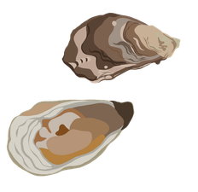
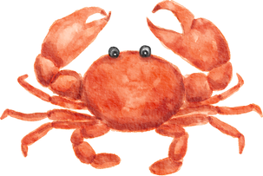
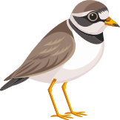

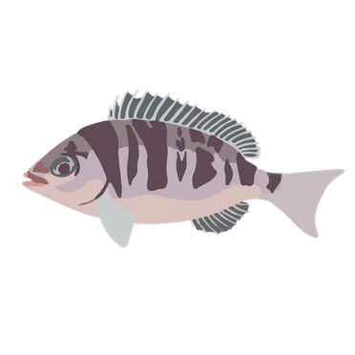
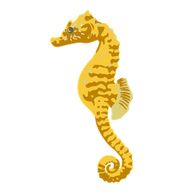

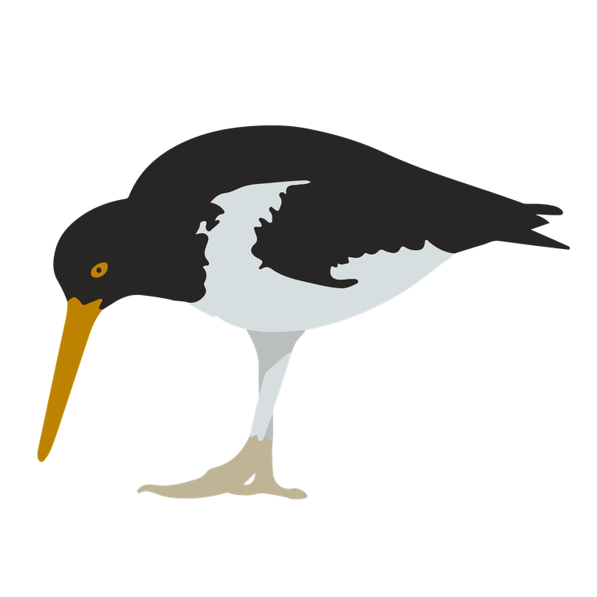
Animals in Danger Card
Animals In Danger Card
Animals In Danger Card
Native Oyster “I’m often found in large numbers forming underwater reefs.” | Crab “I like scuttling around in Seagrass, at the coast and in reefs.” | Ringed Plover “I'm a wading bird who likes wading through marshland and makes nests on bare gravel at the coast.” | Little Tern “I like to live at the coast where I eat marine worms.”
Star Fish “I move around reefs and seagrass meadows eating shellfish and crabs.” | Oystercatcher “I like wading through marshland eating worms, crabs and shellfish." | Fish “Reefs and meadows are perfect places to have baby fish.” | Seahorse “You can find me hiding between leaves.”
Animals In Danger Card
Animals In Danger Card
Animals In Danger Card
Animals In Danger Card
Animals In Danger Card

Slide 6
Coastal Development Marshes are often lost to agriculture and urban development. | Erosion and Storm Damage Strong waves and storms can wash away coastal habitats and affect water quality. | Boat Anchors Dragged across the seabed they can tear up habitat like reefs and meadows. | Climate Change Rising temperatures and sea levels can disturb all marine habitats and the animals that live there.
Disturbance from Dogs Dogs running through nesting sites can scare birds. | Fishing Removing too many species can affect wildlife and types of fishing can destroy reefs and meadows. | Plastic Waste Plastic pollution can injure wildlife like birds. | Disturbance from People Noise and movement can scare nesting birds.
Cause and Consequence card
Cause and Consequence card
Cause and Consequence card
Cause and Consequence card
Cause and Consequence card
Cause and Consequence card
Cause and Consequence card
Cause and Consequence card

Slide 7

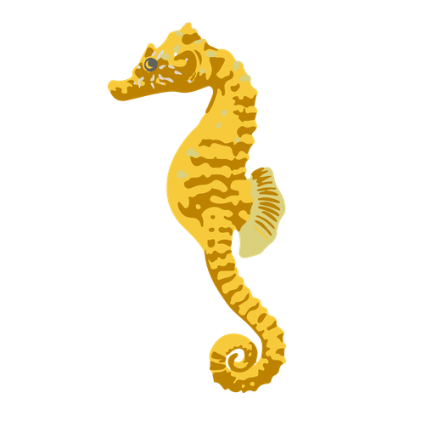
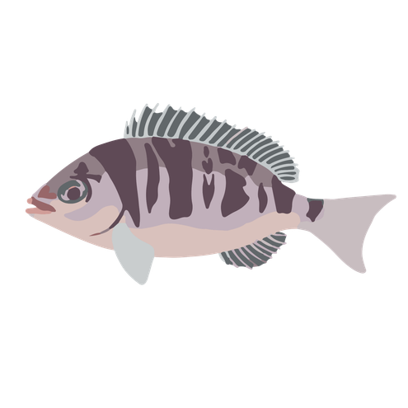
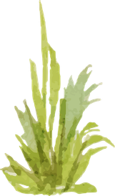
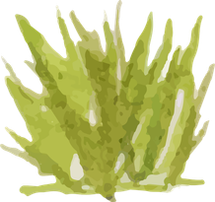
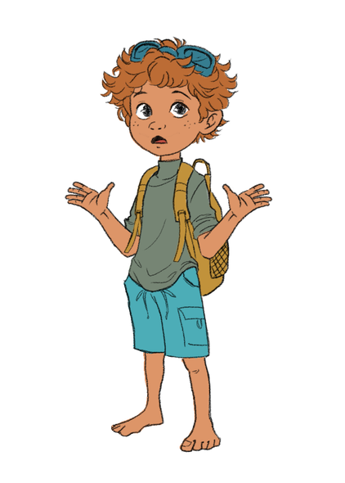
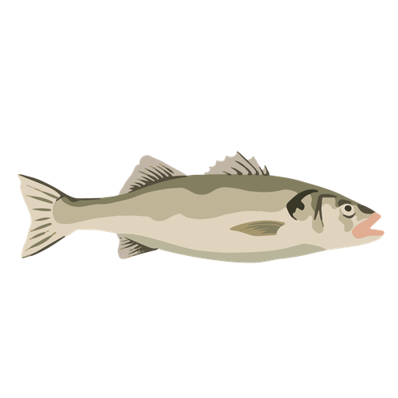
Habitat Case File 1:
THE MISSING MEADOW
Habitat Description: Seagrass meadows are underwater flowering plants found in shallow coastal waters. They create sheltered habitats where many young animals can hide from predators and find food.
.
Evidence Collected
Step 1: Species Affected (Animals In Danger Cards)
Step 2: What’s the problem? (Cause and Consequence cards)
Step 3: Action Box:
Witness Statements
Witness 1 – Local Fisher
“We used to see lots of young fish around here. Now there are far fewer than there used to be.”
Witness 2 – Recreational Diver
“I noticed long bare scars cutting through the seagrass beds. Some areas looked completely torn up.”
Witness 3 – Harbour Worker
“Recently we have seen bigger waves and the water has definitely become murkier.”
Notes:
Clarify what a witness is – what people looking at your habitat are seeing and saying.

Slide 8
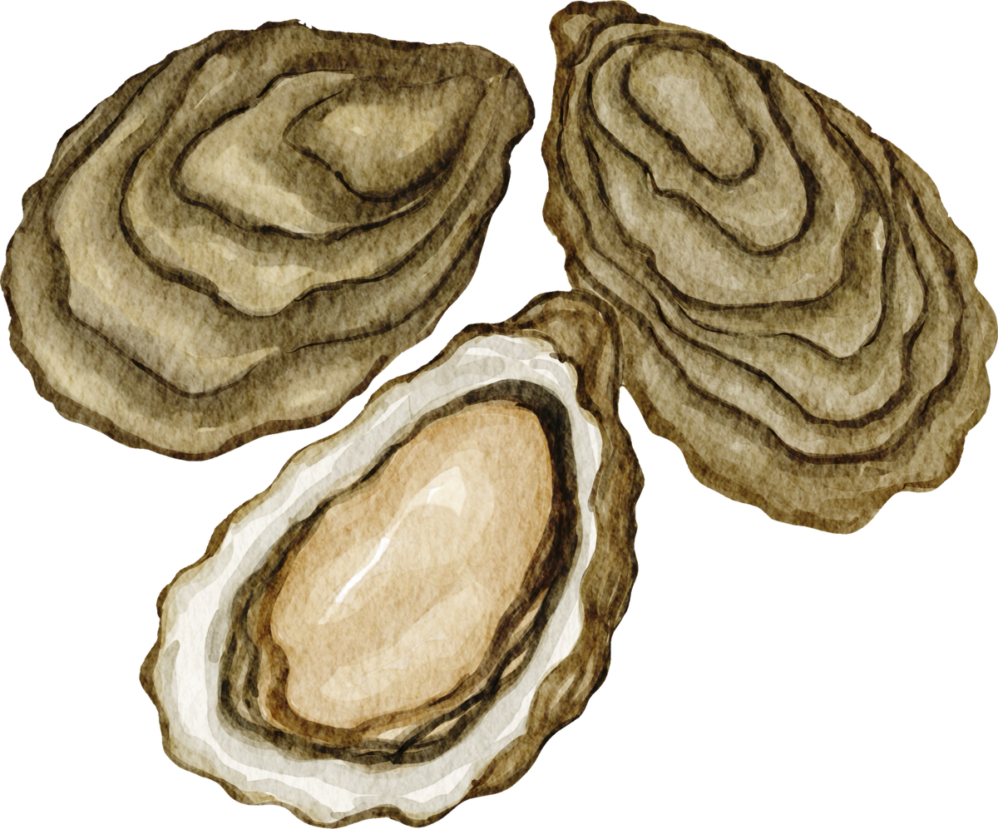
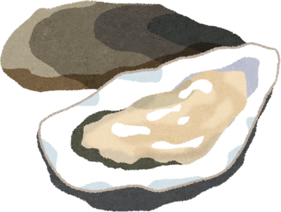
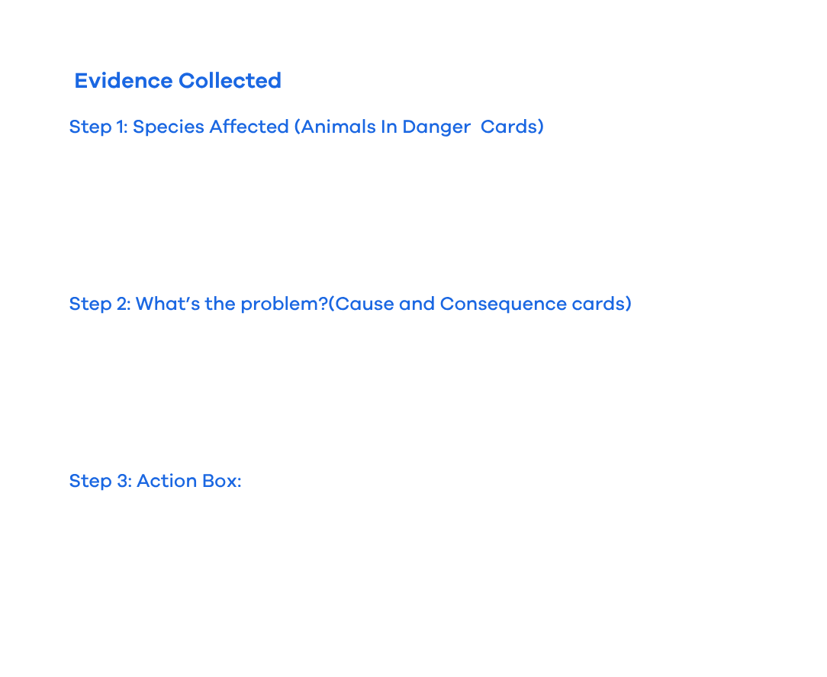
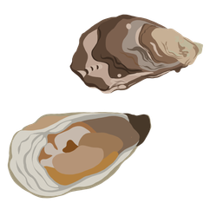
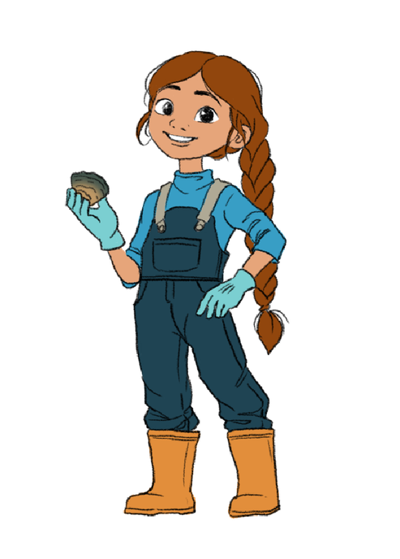
Habitat Case File 2:
THE COLLAPSING REEF
Habitat Description: Native oyster reefs create underwater habitats that support many marine species. Oysters also filter seawater and improve water quality.
Witness Statements
Witness 1 – Local Fisher
“Years ago, there were oyster reefs all across this area. Most of them have disappeared now.”
Witness 2 – Marine Scientist
“The water temperature is rising and it used to look much clearer around the old oyster beds.”
Witness 3 – Local Sailor
“There have been so many more boats stopping and dropping their anchors in the area.”

Slide 9
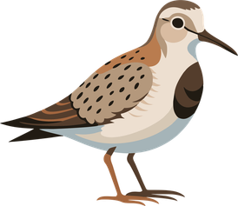
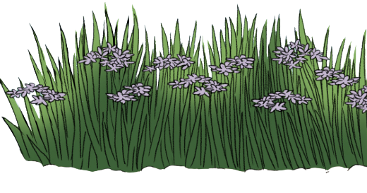

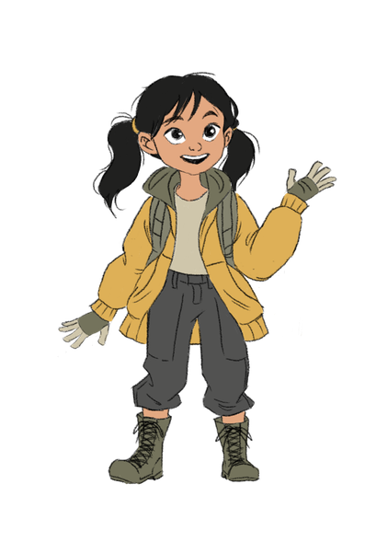
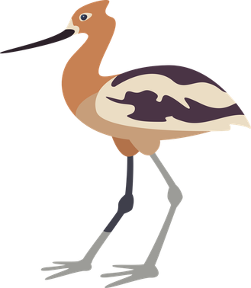
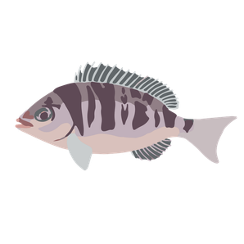
Habitat Case File 3:
THE DISAPPEARING COAST
Habitat Description: Saltmarshes are coastal wetlands that help protect shorelines and provide feeding and nursery habitats for wildlife.
Witness Statements
Witness 1 – Local Resident
“ I don’t recognise this area anymore- it used to be Saltmarsh!”
Witness 2 – Bird Watcher
“There are fewer birds feeding out on the marsh now.”
Witness 3 – Coastal Ranger
“Some parts of the marsh are becoming flooded and eroding much faster than before.”

Slide 10

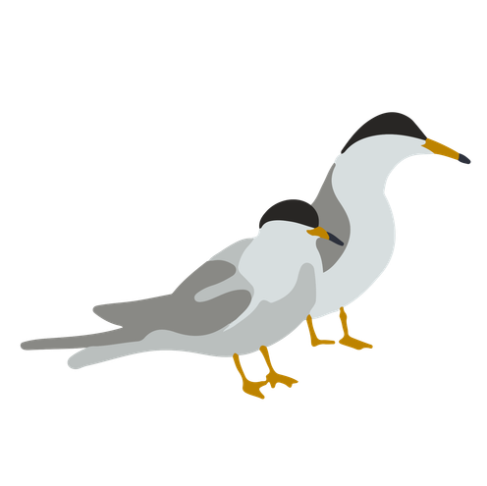


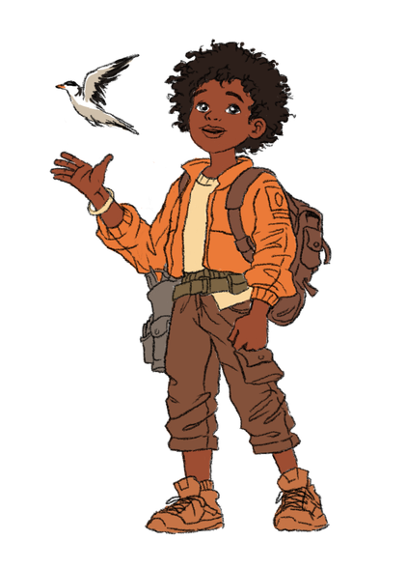

Habitat Case File 4:
THE ABANDONED NESTS
Habitat Description: Coastal seabirds rely on quiet beaches, islands and shingle habitats to safely nest and raise their chicks.
Witness Statements
Witness 1 – Local Resident
“We’ve seen more people and dogs walking through nesting areas they leaving their rubbish behind.”
Witness 2 – Bird Survey Volunteer
“Some people don’t stick to the paths so the birds are scared and abandon their nests before the chicks hatch.”
Witness 3 – Beach Surveyor
“Where the birds used to nest is now underwater, they nest much higher now.”

Slide 11
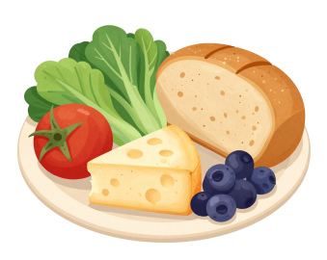

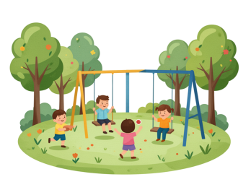
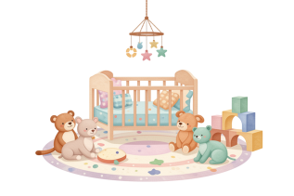
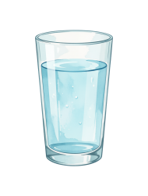
What is a habitat?
A habitat provides everything a living thing needs to survive, what do you need to survive?
Food
Water
Shelter
Space
Safe places to have and raise young
Notes:
“Before we investigate the habitats..we need to understand what a habitat actually is.”
(Point to slide title.)
“Who thinks they can give me a definition of a habitat?”
Take responses and build toward:
“A habitat is a place where a living thing gets everything it needs to survive.”
Then move to bullets one at a time.
“What kinds of things do you need to survive?”
Elicit:
food
shelter
space
safety
somewhere to raise young
“Exactly — and a habitat provides those things.”
“You can think of a habitat as an animal’s home.”

Slide 12
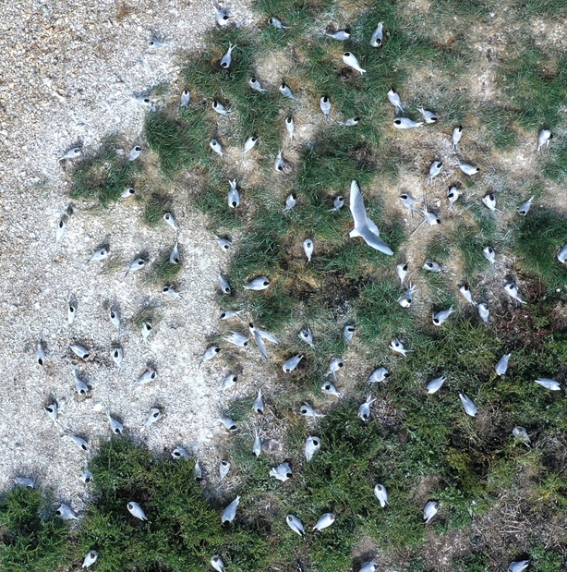
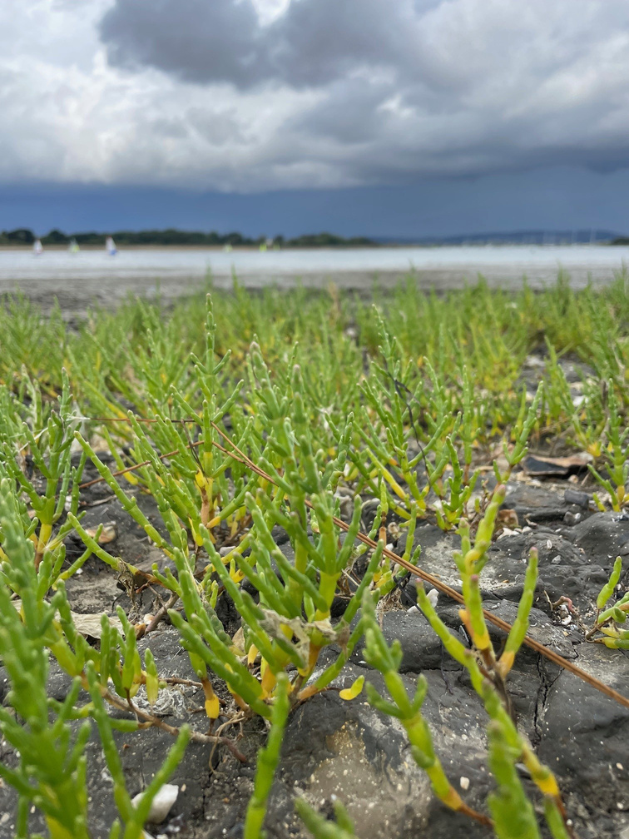
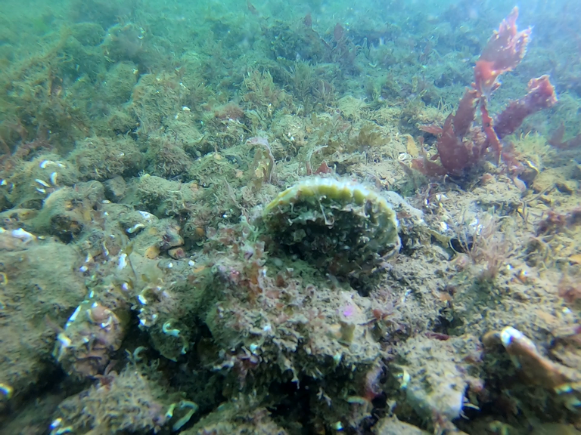
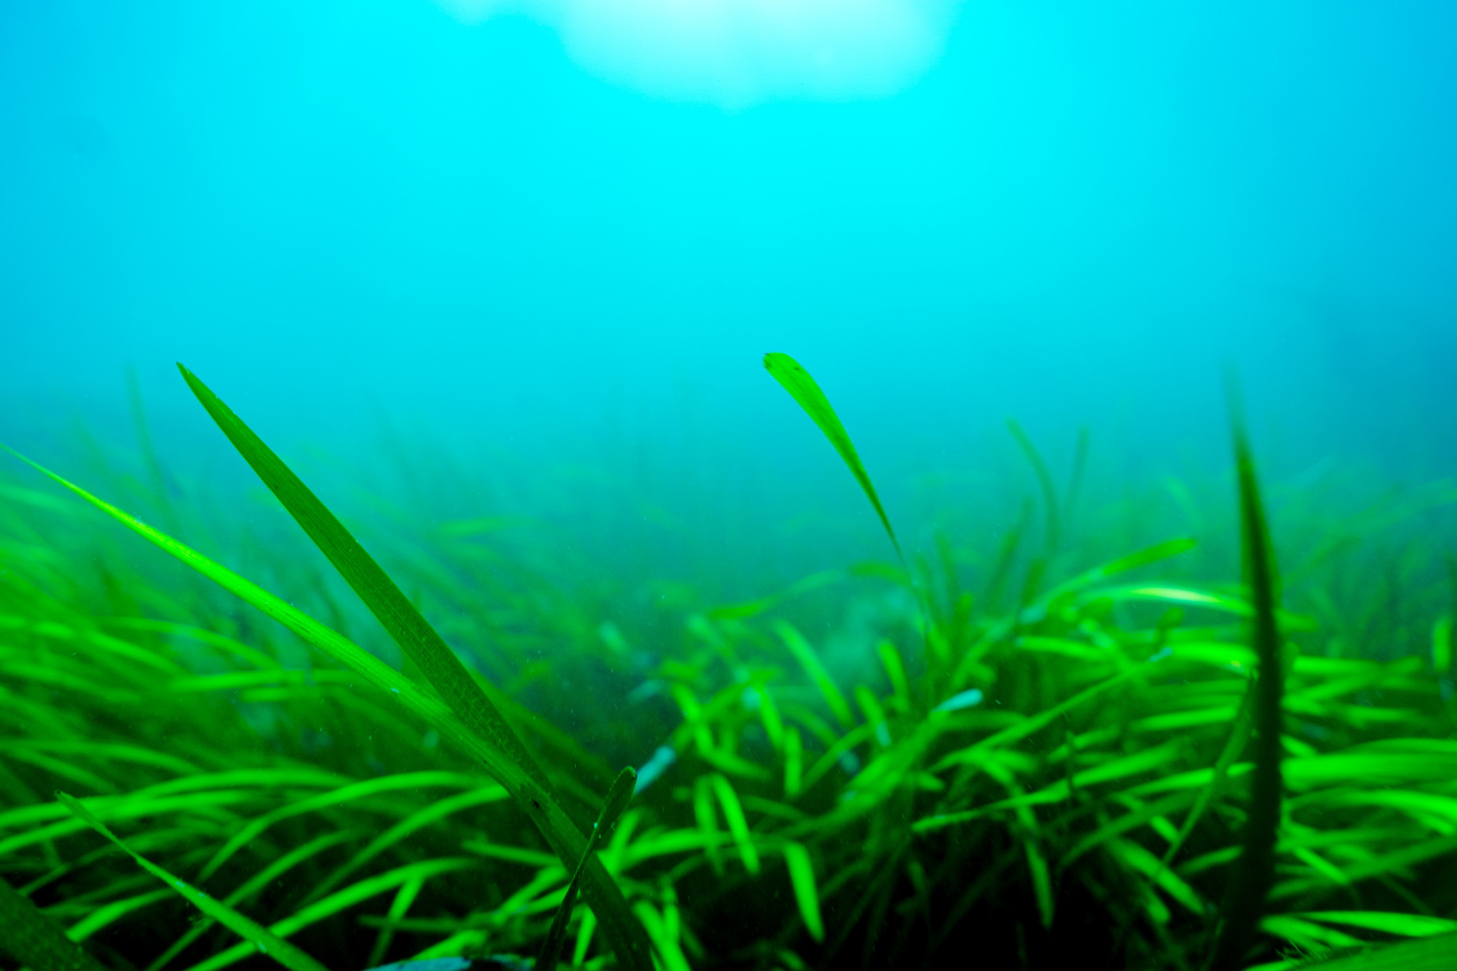
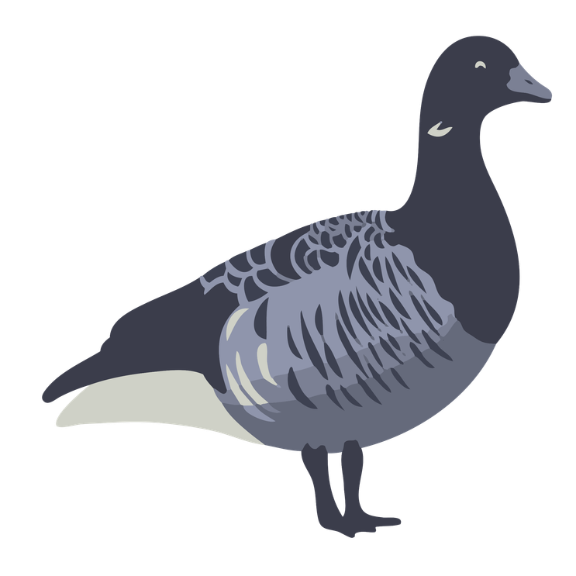



A Solent Mystery: Who lives where?
Match up the Animal to where they live
Seabird nesting site: Credit Wez Smith
Saltmarsh: credit CHaPRoN
Oyster Reef: Credit Andrew Hunt
Seagrass Meadow: Credit Luke Helmer
Native Oyster
Brent Goose
Common Tern
Seahorse
Notes:
Short starter exercise: match the animals to where they live (their habitat).
These are the 4 habitats in the Solent that we will look at today.
The slide is animated with the answers. Can do this as a simple hands up exercise.
Seabird Nesting Site – Common Tern
Saltmarsh – Brent Goose
Oyster Reef- Common Oyster
Seagrass Meadow- Seahorse

Slide 13
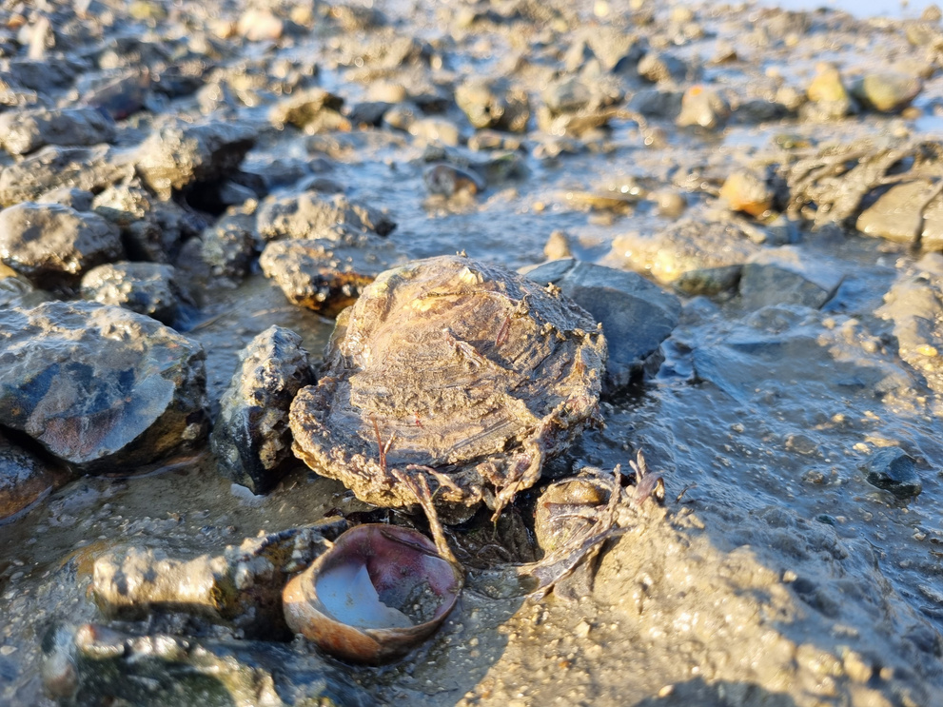
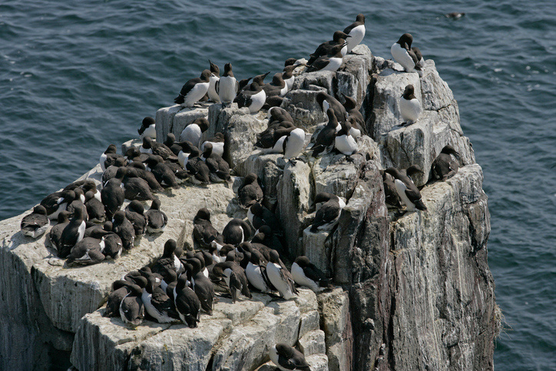
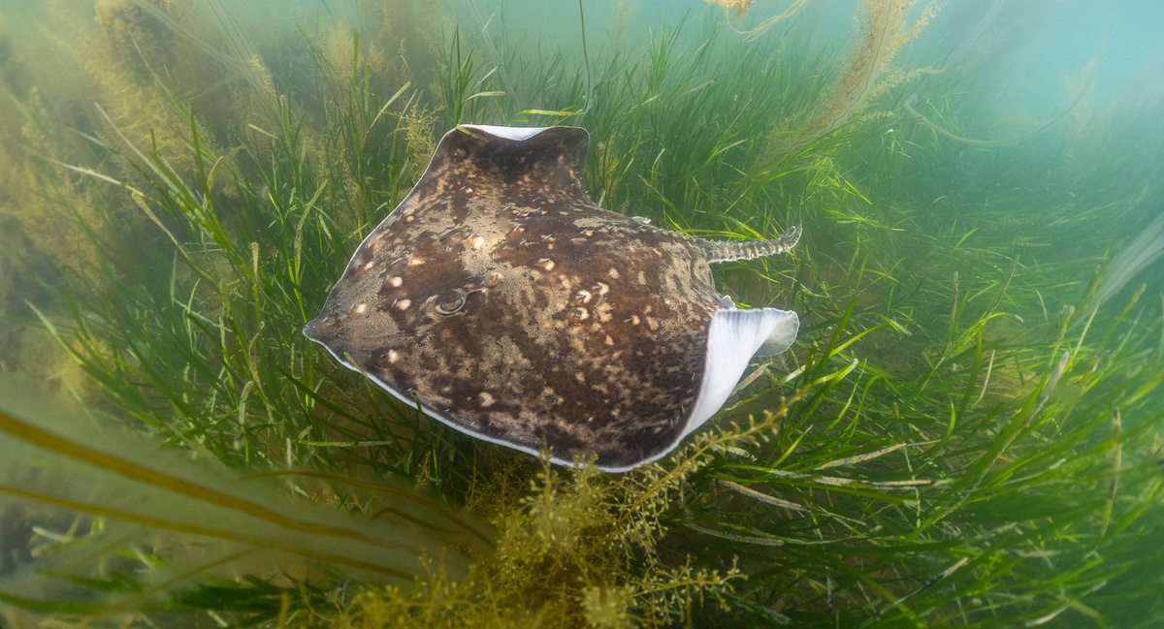
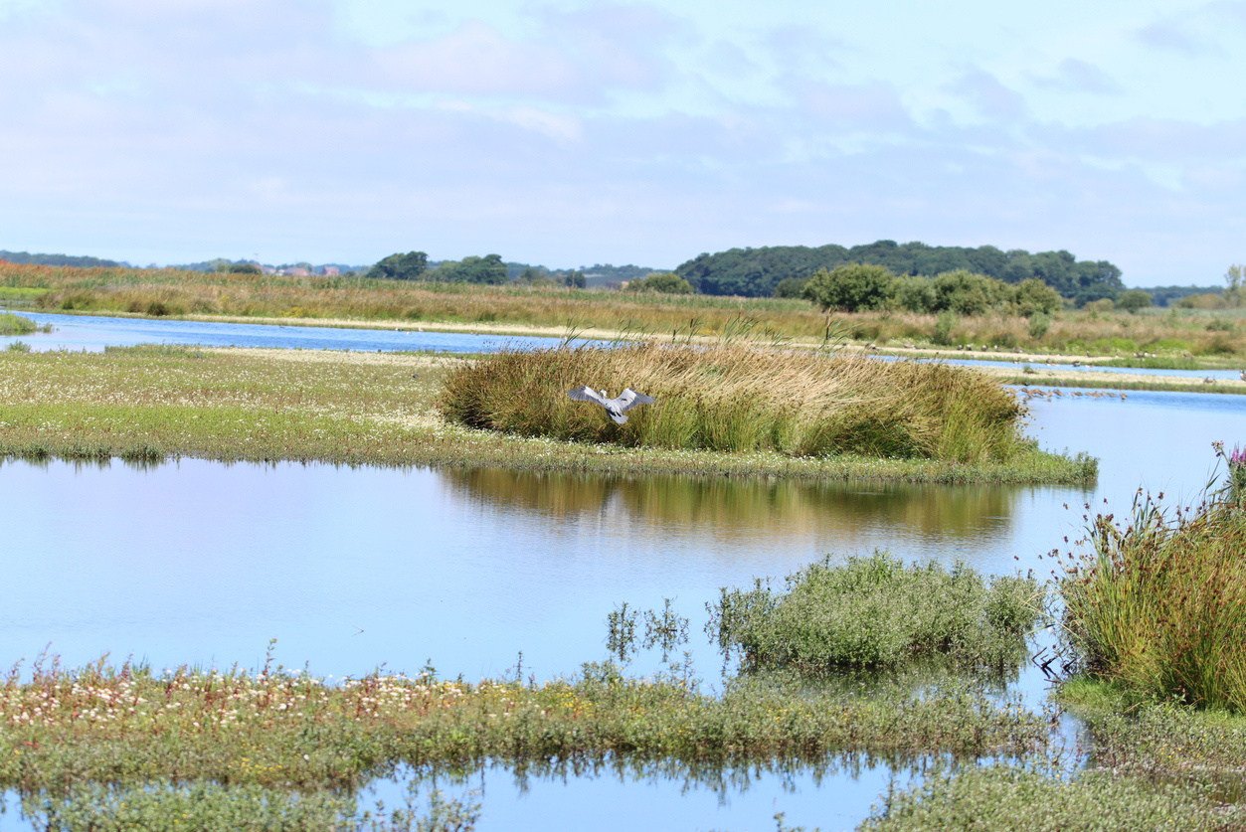
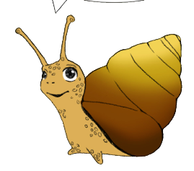

Why Are Healthy Habitats Important?
Learn
  Give lots of different animals' places to live and raise young
  Keep water and air clean
  Protect coastlines from storms and erosion
  Absorb CO₂ to help slow climate change
  Support fishing, tourism, and local communities
Credit Luke Helmer
Credit Theo Vickers
Credit Andrew Hunt
Credit Andy Hunt
Notes:
Why are healthy habitats important?
(Ask class and get feedback)
Give lots of different animals' places to live and raise young
Help keep water and air clean
Protect coastlines from storms and erosion
Absorb Carbon dioxide to help slow climate change
Support fishing, tourism, and local communities
Move onto human benefits.
“Do habitats only help wildlife… or might they help humans too?”
Elicit ideas first.
Possible answers:
food/fishing
cleaner water
tourism
flood protection
climate change/carbon storage
“Exactly. Healthy habitats help people as well as nature.”
“For example:
oyster reefs help clean water,
saltmarsh can reduce flooding,
and seagrass stores carbon that would otherwise contribute to climate change.”
Final section.
“So what might happen if habitats are damaged or disappear?”
Elicit:
animals lose homes
species decline
food chains disrupted
more flooding
dirtier water
fewer fish
“Yes — and that’s exactly what today’s investigation is about.”
“Today you’ll investigate habitats that are under threat in the Solent… and work out what happens if the damage continues.”
“Detectives — it’s time to open the case files.”
“Now that we know a little more about what habitats are :
Detectives — it’s time to open your case files.”
After explaining why habitats are important ask:
“So what might happen if habitats are damaged or disappear?”
Elicit:
animals lose homes
species decline
food chains disrupted
more flooding
dirtier water
fewer fish
“Yes — and that’s exactly what today’s investigation is about.”
“Today you’ll investigate habitats that are under threat in the Solent… and work out what happens if the damage continues.”
“Detectives — it’s time to open the case files.”

Slide 14
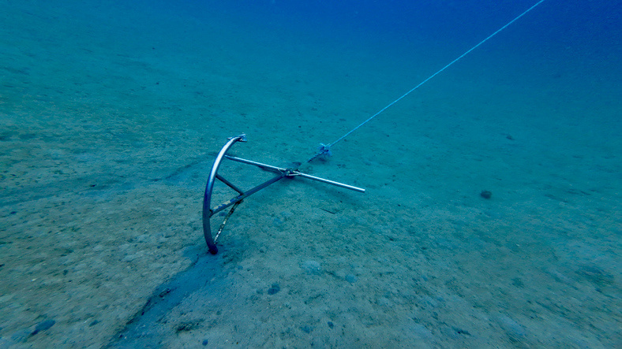
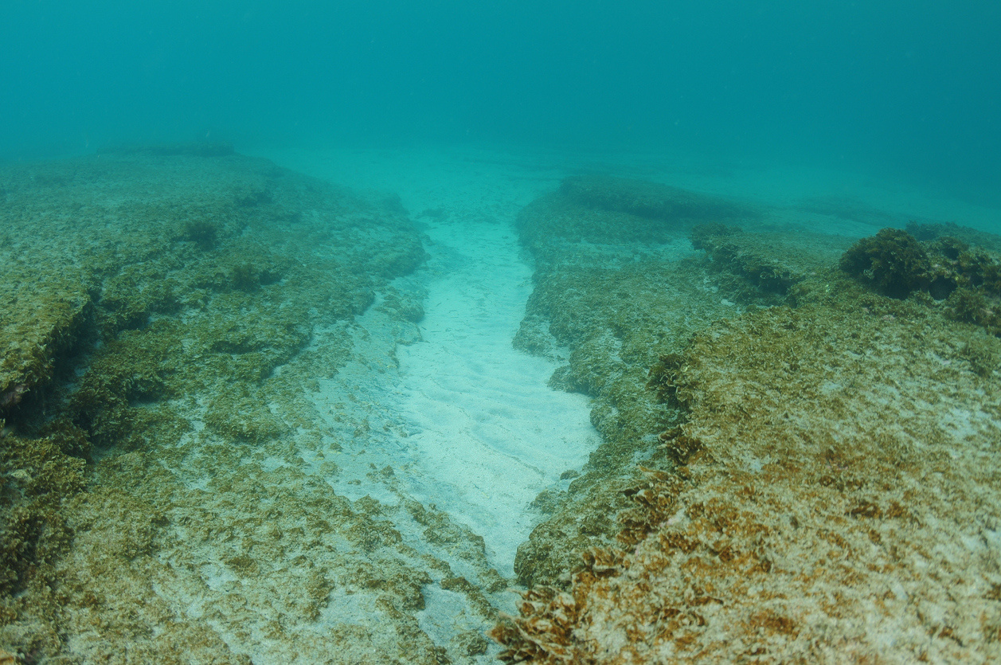
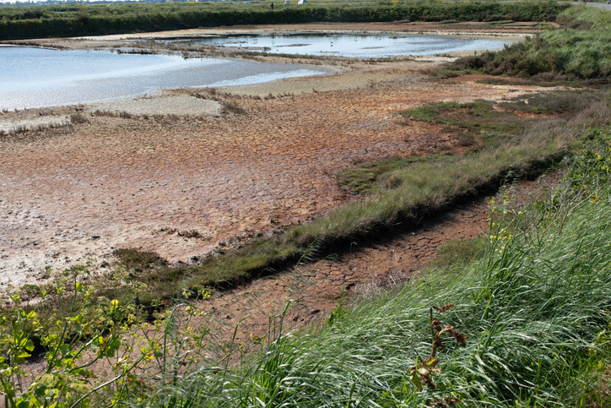
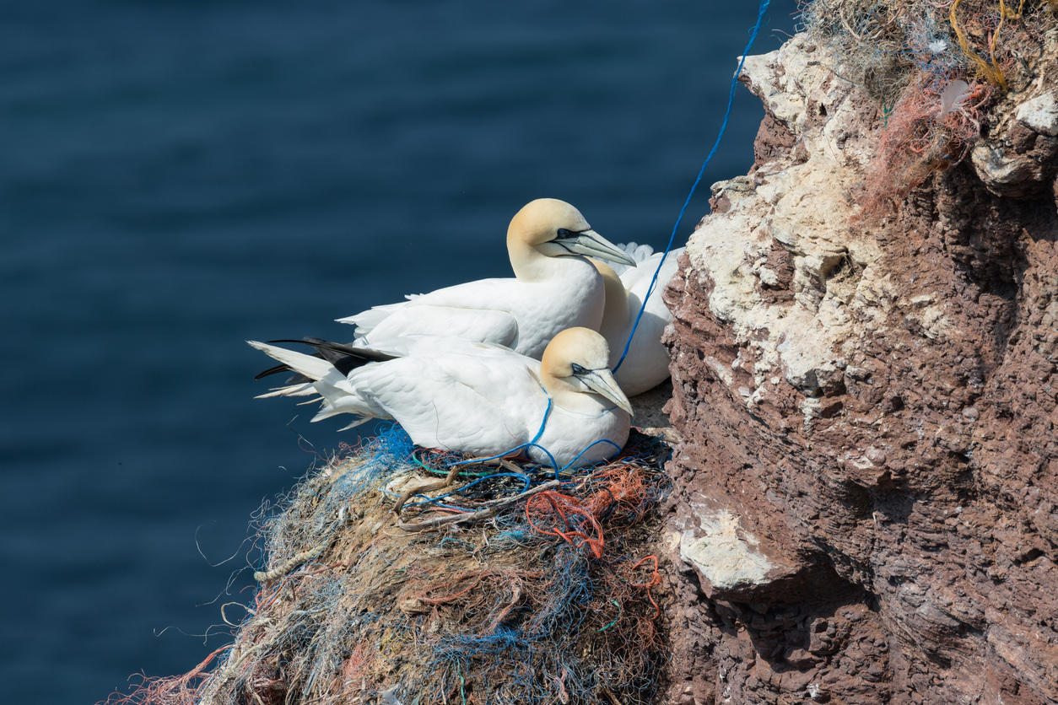
What Happens When Habitats Are Damaged?
  Animals lose their homes
  Food chains are negatively changed
  Species survival put at risk
  Humans can also be affected
  Increased flooding and coastal erosion
  Reduced water quality
  Makes climate change worse
Notes:
What happens when habitats are damaged?
Animals lose their homes
Food chains are negatively changed
Species survival put at risk- teachers can mention endangered
Humans can also be affected – include what these effects are
Increased flooding and coastal erosion- flooding of urban areas
Reduced water quality – can’t swim in the water for health risks
Worsening Climate change
“Yes — and that’s exactly what today’s investigation is about.”
“Today you’ll investigate habitats that are under threat in the Solent… and work out what happens if the damage continues.”
“Detectives — it’s time to open the case files.”

Slide 15
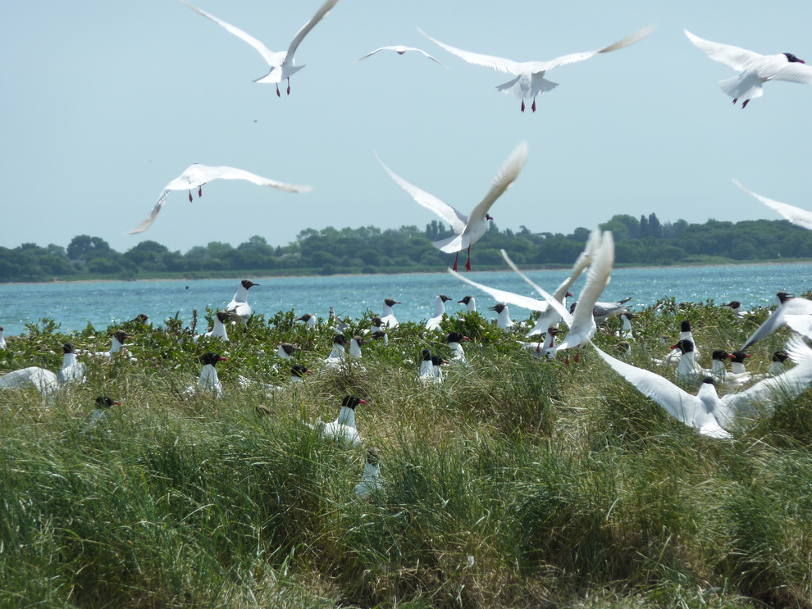
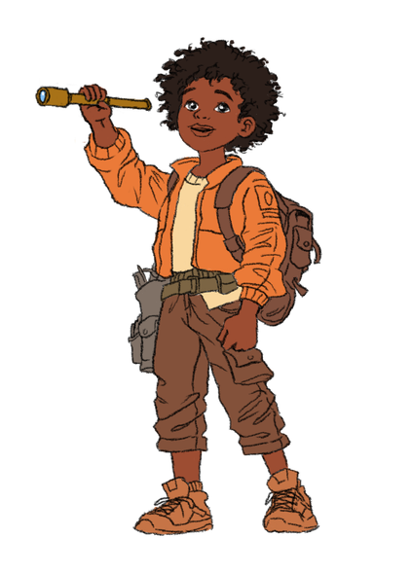

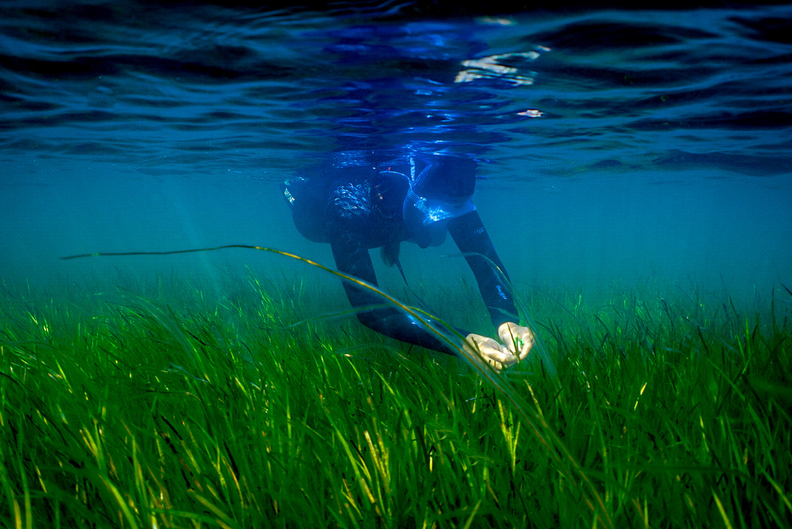
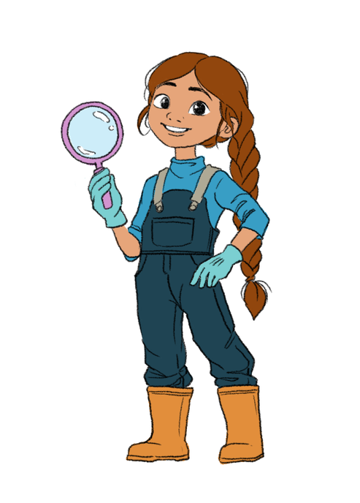
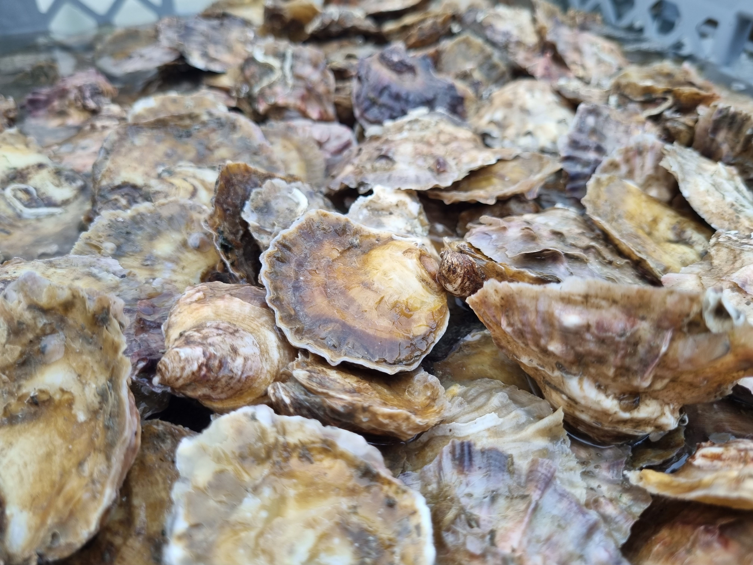
Welcome to Habitat Detectives !
Credit Louise MacCallum
Credit CHaPRoN
Credit Luke Helmer
Credit Luke Helmer
Notes:
“Welcome to the Habitat Investigation.”
“Today, you are marine habitat detectives.”
“Some important habitats in the Solent have been damaged, and we need your help to investigate what’s happened.”
“Your mission is to identify:
Which species rely on them
What is damaging them
Why these habitats matter
What could happen if the damage continues
How we can help protect and restore them

Slide 16



Step 1 – Who are the Animals in danger ?
In your group:
  Read through your Habitat Case File.
  2. Use the Animals In Danger Cards to decide which plants and animals will be affected if the habitat is destroyed.
  3. Write down the animals that would be in danger on your case file.
Credit: Theo Vickers
Credit: Theo Vickers
Notes:
Read through the slide

Slide 17

Step 2 – What's The Problem?
In your group:
  Read through the witness statements – what people see and say.
  2. Look through the Cause and Consequence cards and decide which threats could be affecting your habitat.
  3. Write down the Cause and Consequence into the 'What's the Problem' box on your Habitat Casefile.
Credit: ?
Notes:
Read through the slides.

Slide 18

Step 3 – Recommend an Action
You have identified:
✔ The Animals In Danger (species affected)
✔ The causes and the consequences (the problem and impact)
Example
Threat/cause:
Boat anchors damaging seagrass.
Consequence:
Seagrass is destroyed and young fish lose shelter.
Now your team must decide: How could we help?
Think About Your Threat
Ask yourselves:
How could we reduce the damage?
How could we protect the habitat?
What actions we can take to help it recover?
Recommended Action:
Ban anchoring over seagrass meadows.
Why?
This would reduce damage and allow seagrass to recover.
Write your ideas in the Action box on your Habitat Case File.
Credit: Matt Jarvis
Notes:
Encourage students to think logically from the threat rather than searching for a “correct” answer.
Prompt with:
“If this is the problem… what could humans do differently?”
“How could we stop this damage happening?”
“How could we give the habitat a chance to recover?”
If groups struggle, guide rather than tell:
Pollution → reduce pollution/run-off
Disturbance → protected areas/signs/restrictions
Overfishing → fishing limits/protected zones
Habitat destruction → restoration/protection

Slide 19

Report back
Your team must share:
1.What habitat did you investigate?
2.Which species were affected? (Animals In Danger cards chosen)
3.What caused the problem? (Cause and Consequence cards chosen)
4.How could we help protect or restore the habitat? (Action Box)
Credit Peter Barritt
Notes:
Call students together and explain that each group will now report their findings to everyone.
They should use the worksheets they filled in to report back.
Facilitate/ encourage by asking the group each question and turn and ensure they know which cards they are looking at if they need support
Every member of the team should contribute at least one point if possible.
You can increase engagement through questions: based upon each box on the worksheet.
Finish with:
“Why should humans care about this habitat?”
Optional idea: As groups present, record key points on the board under:
Habitat
Species affected
Threats
Human impacts
Solutions
This helps the class compare all four habitats and reinforces the idea that marine ecosystems are interconnected.
19

Slide 20













The Solent Seascape Project
Today, you investigated the habitats under threat in the Solent, but this is not just a classroom investigation.
Real scientists, conservationists and local communities are already working to restore these habitats through the Solent Seascape Project.
The project is helping to:
  restore seagrass meadows
  rebuild oyster reefs
  protect seabird nesting sites
  help saltmarsh recover
Because habitats work together,
restoring one habitat can help
others recover too.
Francesco
Matt
Notes:
Use this slide to transition from the previous activities into the real-world conservation project.
“Your’ investigations today mirror the kinds of questions scientists and conservation teams ask when restoring habitats:
What has been damaged?
What caused it?
Which species are affected?
How can recovery happen?
The Solent Seascape Project is a real, large-scale restoration programme working across the Solent to reconnect habitats including seagrass, oyster reefs, saltmarsh and seabird nesting areas.
Seagrass that helps stabilise sediment.
Oyster reefs that improve water quality.
Saltmarsh that reduce erosion and flooding.
Healthy habitats support all marine animals. “

Slide 21

The Solent Seascape Project
Notes:
Video is 4min 20 seconds long
22

Slide 22


“Protect Solent Habitats!”
Protect the Solent signs and poster activity:
Raising awareness through signs and posters helps with the protection and recovery of these habitats.
Using what you have learned today, create a sign or poster to raise awareness of:
  The threats the habitat faces
  The species they protect
  Why they are important
  How people can support
Credit: Luke Helmer
Notes:
Introduction (1–2 mins) This could be a homework task!
Explain that many people visit beaches and the coast without knowing about the important habitats and wildlife that live there. Signs and posters can help people understand why these places matter and how they can help protect them.
Instructions
Pupils should create a sign or poster that could be displayed near a coastal habitat in the Solent.
They can choose the habitat they investigated earlier or select another habitat covered in the lesson.
Encourage them to think about what information would be most useful to members of the public.
Their poster should include:
The name of the habitat.
At least one or two species that live there.
Why the habitat is important (e.g. provides homes for wildlife, nursery areas for young animals, stores carbon, helps keep water clean, protects coastlines).
Threats facing the habitat (e.g. pollution, litter, disturbance, habitat loss, climate change).
Actions people can take to help protect it.
A slogan to protect the habitat.
Bring posters with them on the field trip!
Plenary (if there is time)
Invite pupils to share their posters and explain the key message they want the public to remember. Discuss which posters would be most effective at encouraging people to protect coastal habitats and why.
20

Slide 23



Thank you
Photo Credit: Lawson Wood, Ocean Eye Films

