Slide 1
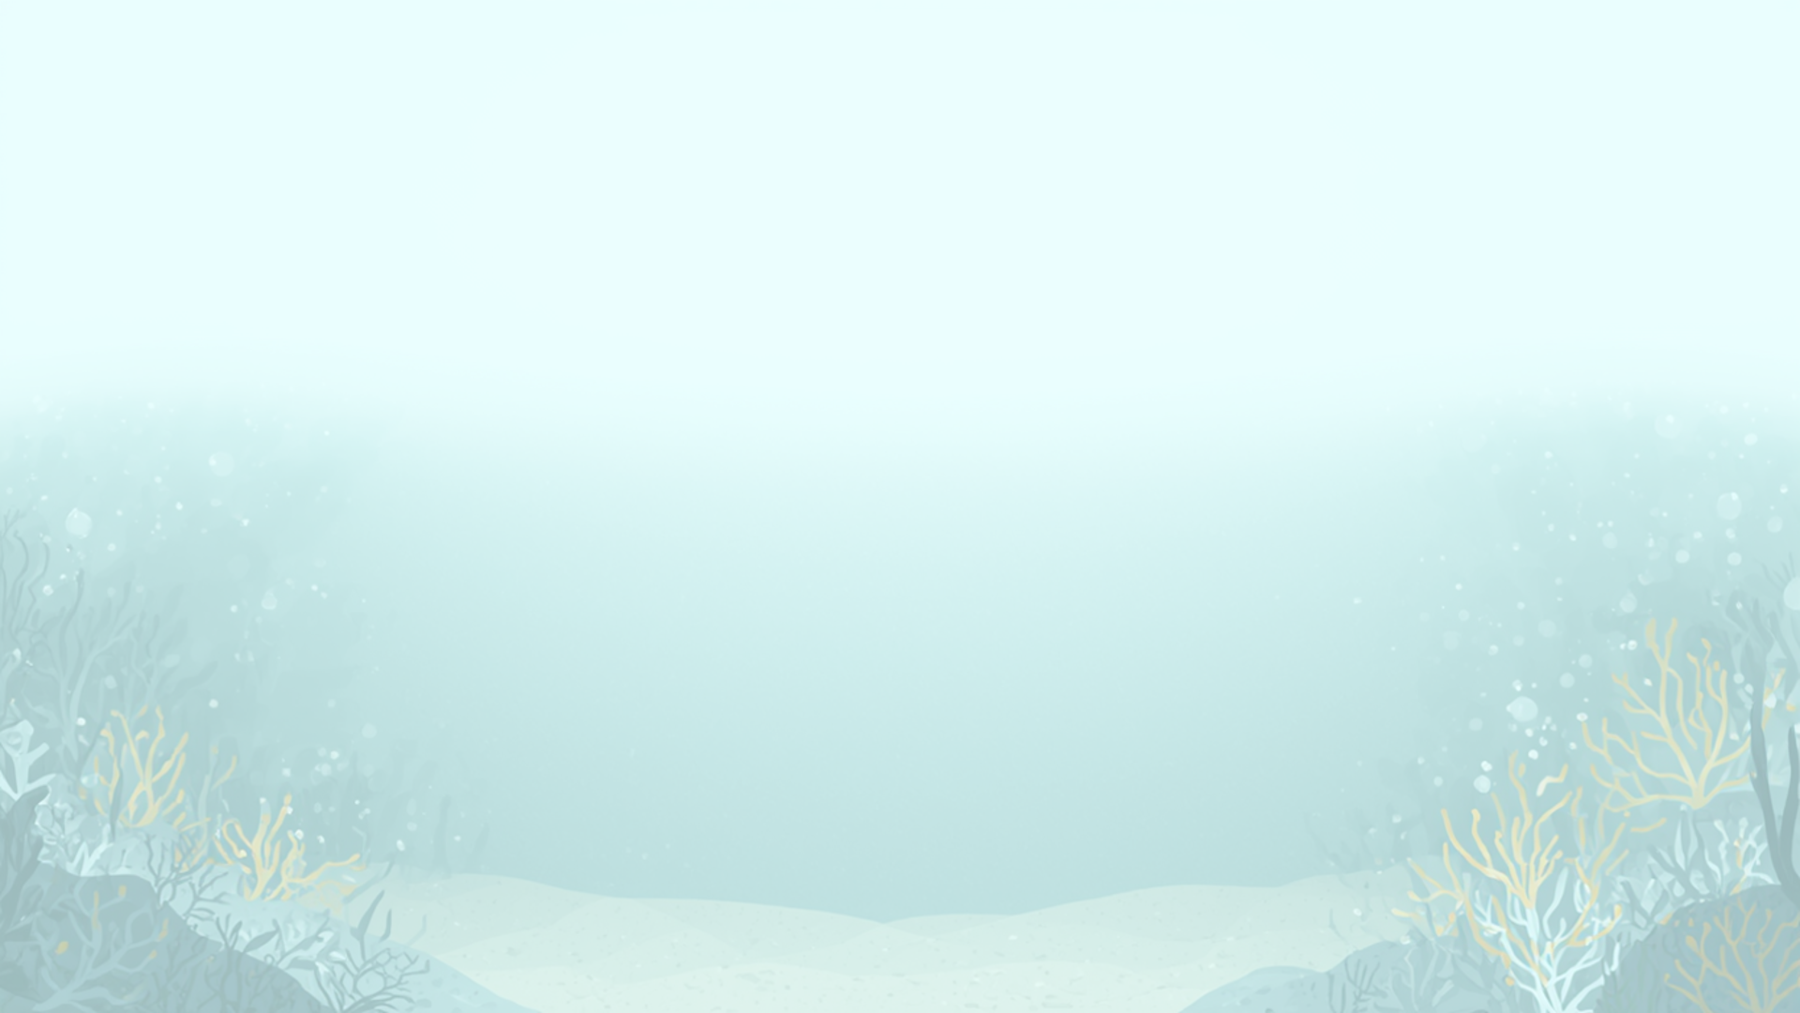

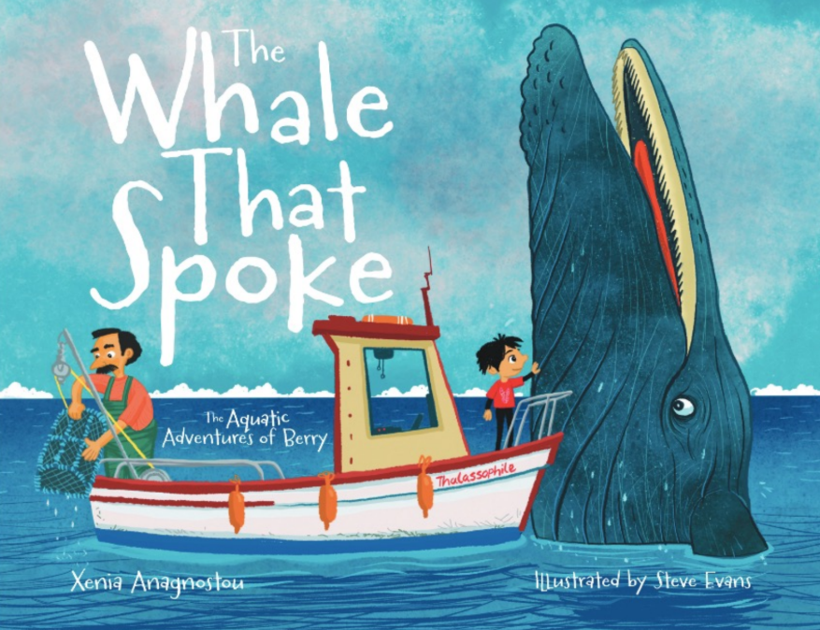

Ready for an Ocean Adventure?

Slide 2
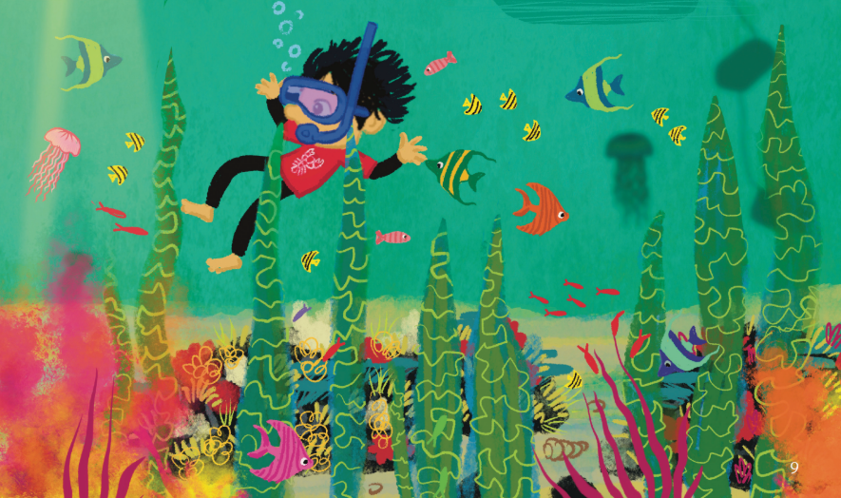
Learning Objectives
The ocean is home to a variety of different marine habitats and animals. These face many threats so need our help and protection.
I can...
1. Describe what a habitat is and explain why they are important.
2. Understand seagrass meadows as an important habitat.
3. Name the different animals found in these underwater habitats.
4. Understand the threats damaging marine habitats and the potential consequences to the creatures, including overfishing and pollution.
5. Learn ways people can protect and restore marine habitats.
  Understand what a MPA is and what it protects.
Notes:
Change image
Sep for year 1, 2 and 3

Slide 3

Curriculum links (KS1)
Science | Science
Living Things and Their Habitats | Recognise that living things live in habitats to which they are suited
Living Things and Their Habitats | Describe how habitats provide animals and plants with what they need to survive
Living Things and Their Habitats | Identify how environments can change and how this can affect living things
Working Scientifically | Working Scientifically
Students will make simple conclusions | Students will make simple conclusions
Students will communicate findings | Students will communicate findings
Students will discuss environmental problems and solutions | Students will discuss environmental problems and solutions
Geography | Geography
Human and Physical geography | Coastal environments and habitats
Human and Physical geography | Human impacts on environments
Human and Physical geography | Caring for and protecting environments
Human and Physical geography | Sustainability and conservation
Notes:
Edit this- to be hidden from lesson

Slide 4
Lesson overview
Section | Time | Summary | Additional Resources
Learning Objectives | 2-3 mins | Introduces ‘The Whale That Spoke’ book and the key content covered.
Meet Berry Intro | 2-3 mins | Children are introduced to the character of ‘Berry’ and the context of the book with either a puppet or short animation. | Puppet/ Animation
Listening to the book reading | 10 mins | Reading of ‘The Whale That Spoke’.
Activity | 20 mins | Short activity covering relevant themes from the book. Activity chosen dependent on the year group. | Dependent on the actvity- listed below each activity.
Plenary Worksheet | 10 mins | Short worksheet requiring pupils to engage with one key conservation theme covered in the book. Includes short written answers and multiple choice questions. | Worksheet Pen/Pencils.
Notes:
4

Slide 5
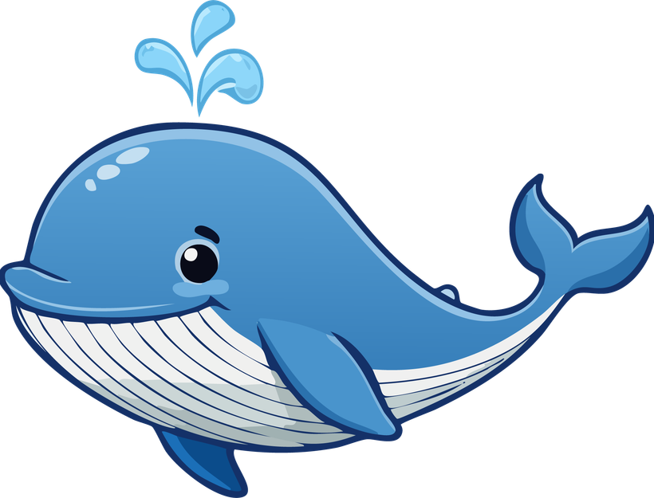

Introduction
Hello Ocean Explorers! 🌊
Today we are going on an ocean adventure with Berry
Let’s read Berry’s story and discover what happens to him and Nadia
Help Berry solve ocean challenges
Become Ocean Explorers
Xenia Anagnostou
Author of the Whale That Spoke
Blue Marine Foundation
Protecting the ocean and restoring marine life
Notes:
"Hello everyone! My name is Xenia, and I wrote the book The Whale That Spoke: The Aquatic Adventures of Berry.
Today, we're going to go on an ocean adventure with Berry. We're going to read his story, meet Nadia, and discover some of the challenges that animals in the ocean face.
But today isn't just about listening to a story. Berry is going to need your help!"
And we have some extra ocean helpers with us today! Blue Marine Foundation works to protect our oceans and help marine animals and their homes. They work with people around the world to make sure our oceans stay healthy for animals and for us.
"Today, we're going to learn about some of the things they work on, and you'll get to become Ocean Helpers yourselves."
"Are you ready to meet Berry and join his adventure?"

Slide 6
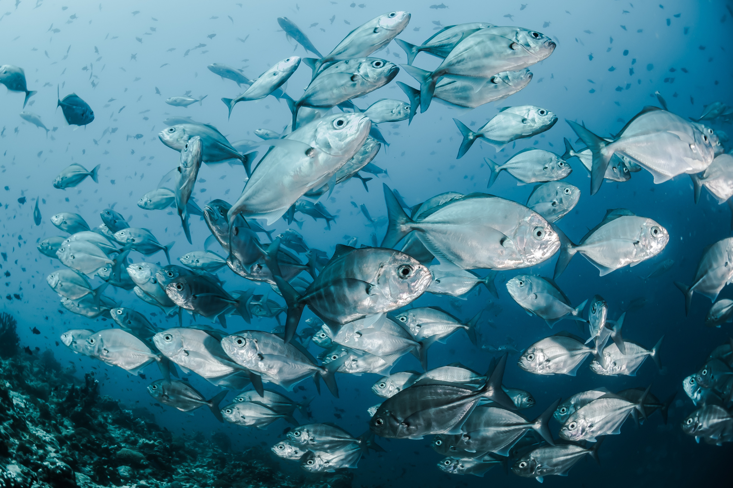
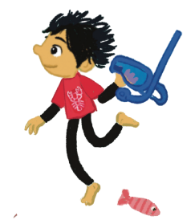

Let’s meet Berry
pictures, puppet, animation video
Hello everyone! My name is Berry.
I’m so happy you’re here because I’m about to take you on a very special ocean adventure.
When I met my friend Nadia the whale, she showed me just how amazing our ocean is, and how many wonderful creatures call it home. But she also helped me understand that our ocean needs our help.
My dad is a lobster fisherman. He loves the sea and wants to make sure there are plenty of whales, fish, lobsters and other sea creatures in our ocean for many years to come.
Nadia asked me to find some special Ocean Helpers, children who care about the sea and want to help protect it.
So, are you ready to join me, become Ocean Helpers and take on today’s ocean mission?
Let’s begin!
Notes:
should this come after the book reading? if not maybe need to reword slightly
Reword.

Slide 7
Mission One: Book Reading
Are you ready to discover Berry’s adventures and start your ocean journey ?.....
You know some of the problems that Nadia and her ocean friends face. But Berry doesn't just want to talk about the problems, he wants to find solutions! Are you ready to become Ocean Helpers and complete your first mission?
Notes:
lets think about more/different questions
hide the discussion questions.
1. What would you do if you were Berry?
We expect to hear:
-Help Nadia.
-Try to remove or report the danger.
-Tell other people about what is happening.
-Ask friends, teachers or adults to help.
-Find ways to protect the ocean and marine animals
2. Why is it important to protect the ocean?
We expect to hear:
- The ocean is home to many animals.
- Animals need a healthy ocean to survive.
- The ocean provides food and resources for people.
- We want animals and their habitats to be protected for the future.
- The ocean is an important part of our planet.
3. What are some dangers creatures in the ocean face?
We expect to hear:
- Plastic pollution and litter.
Fishing nets and entanglement.
- Overfishing.
- Damage to their habitats.
- Boats and other human activities.
- Losing places to feed, hide or raise their young.

Slide 8
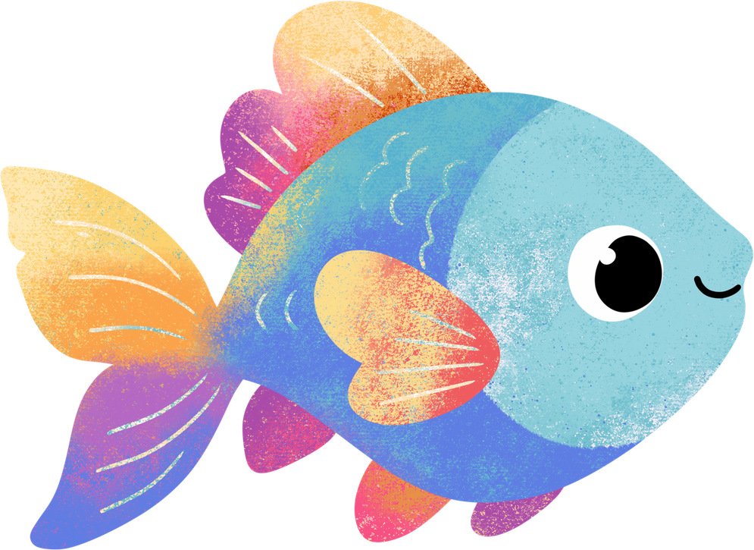
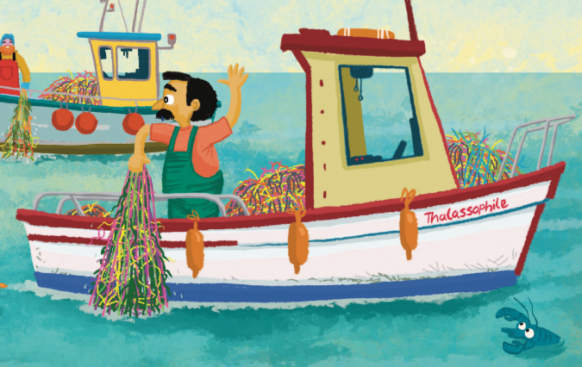
Activity 1- Year 1
Berry’s Dad needs your help!
What does ‘being responsible’ mean?
Can you help Berry's dad become a responsible fisherman?
He wants to make sure there are lots of lobsters in the sea for the future.
Your mission:
1) Catch and measure your lobster
2) Is it big enough?
3) Too small?-> Put it back!
Notes:
"Berry's dad catches lobsters using lobster pots. But he wants to make sure there will always be lots of lobsters in the sea. Today, you're going to help him to be a responsible fisherman.
What does being responsible mean?
Being responsible means doing what you're supposed to do in a way that doesn't negatively effect others.
First, measure your lobster. Is it big enough to keep, or is it still a baby?
"If the lobster is smaller than 9 cm, it goes back into the sea so it can grow."
If it's too small, we put it back into the sea so it can grow."
Then ask the children:
1) Why do you think we put the little lobsters back?They are still babies/young lobsters.
They need time to grow.
They are too small to catch/keep.
They need to stay in the sea.
2) What happens when they grow bigger?They become adult lobsters.
They can reproduce/have babies.
There will be more lobsters in the sea.
They become part of the adult lobster population.
3) Why do we need to leave some lobsters in the sea?So there are enough lobsters in the future.
So they can reproduce.
So there will continue to be healthy lobster populations.
So people can continue fishing sustainably in the future.
Resources:
- cardboard/paper lobsters (all different sizes)
- rulers
- two basket labelled keep or back to the sea
-a big basket labelled sea
-carboard pots for fishing
Plenary: simple fact sheet? drawing?
3d printed or paper- look into costs and resources. Put your hand up question after the activities (pre and post surveys).

Slide 9
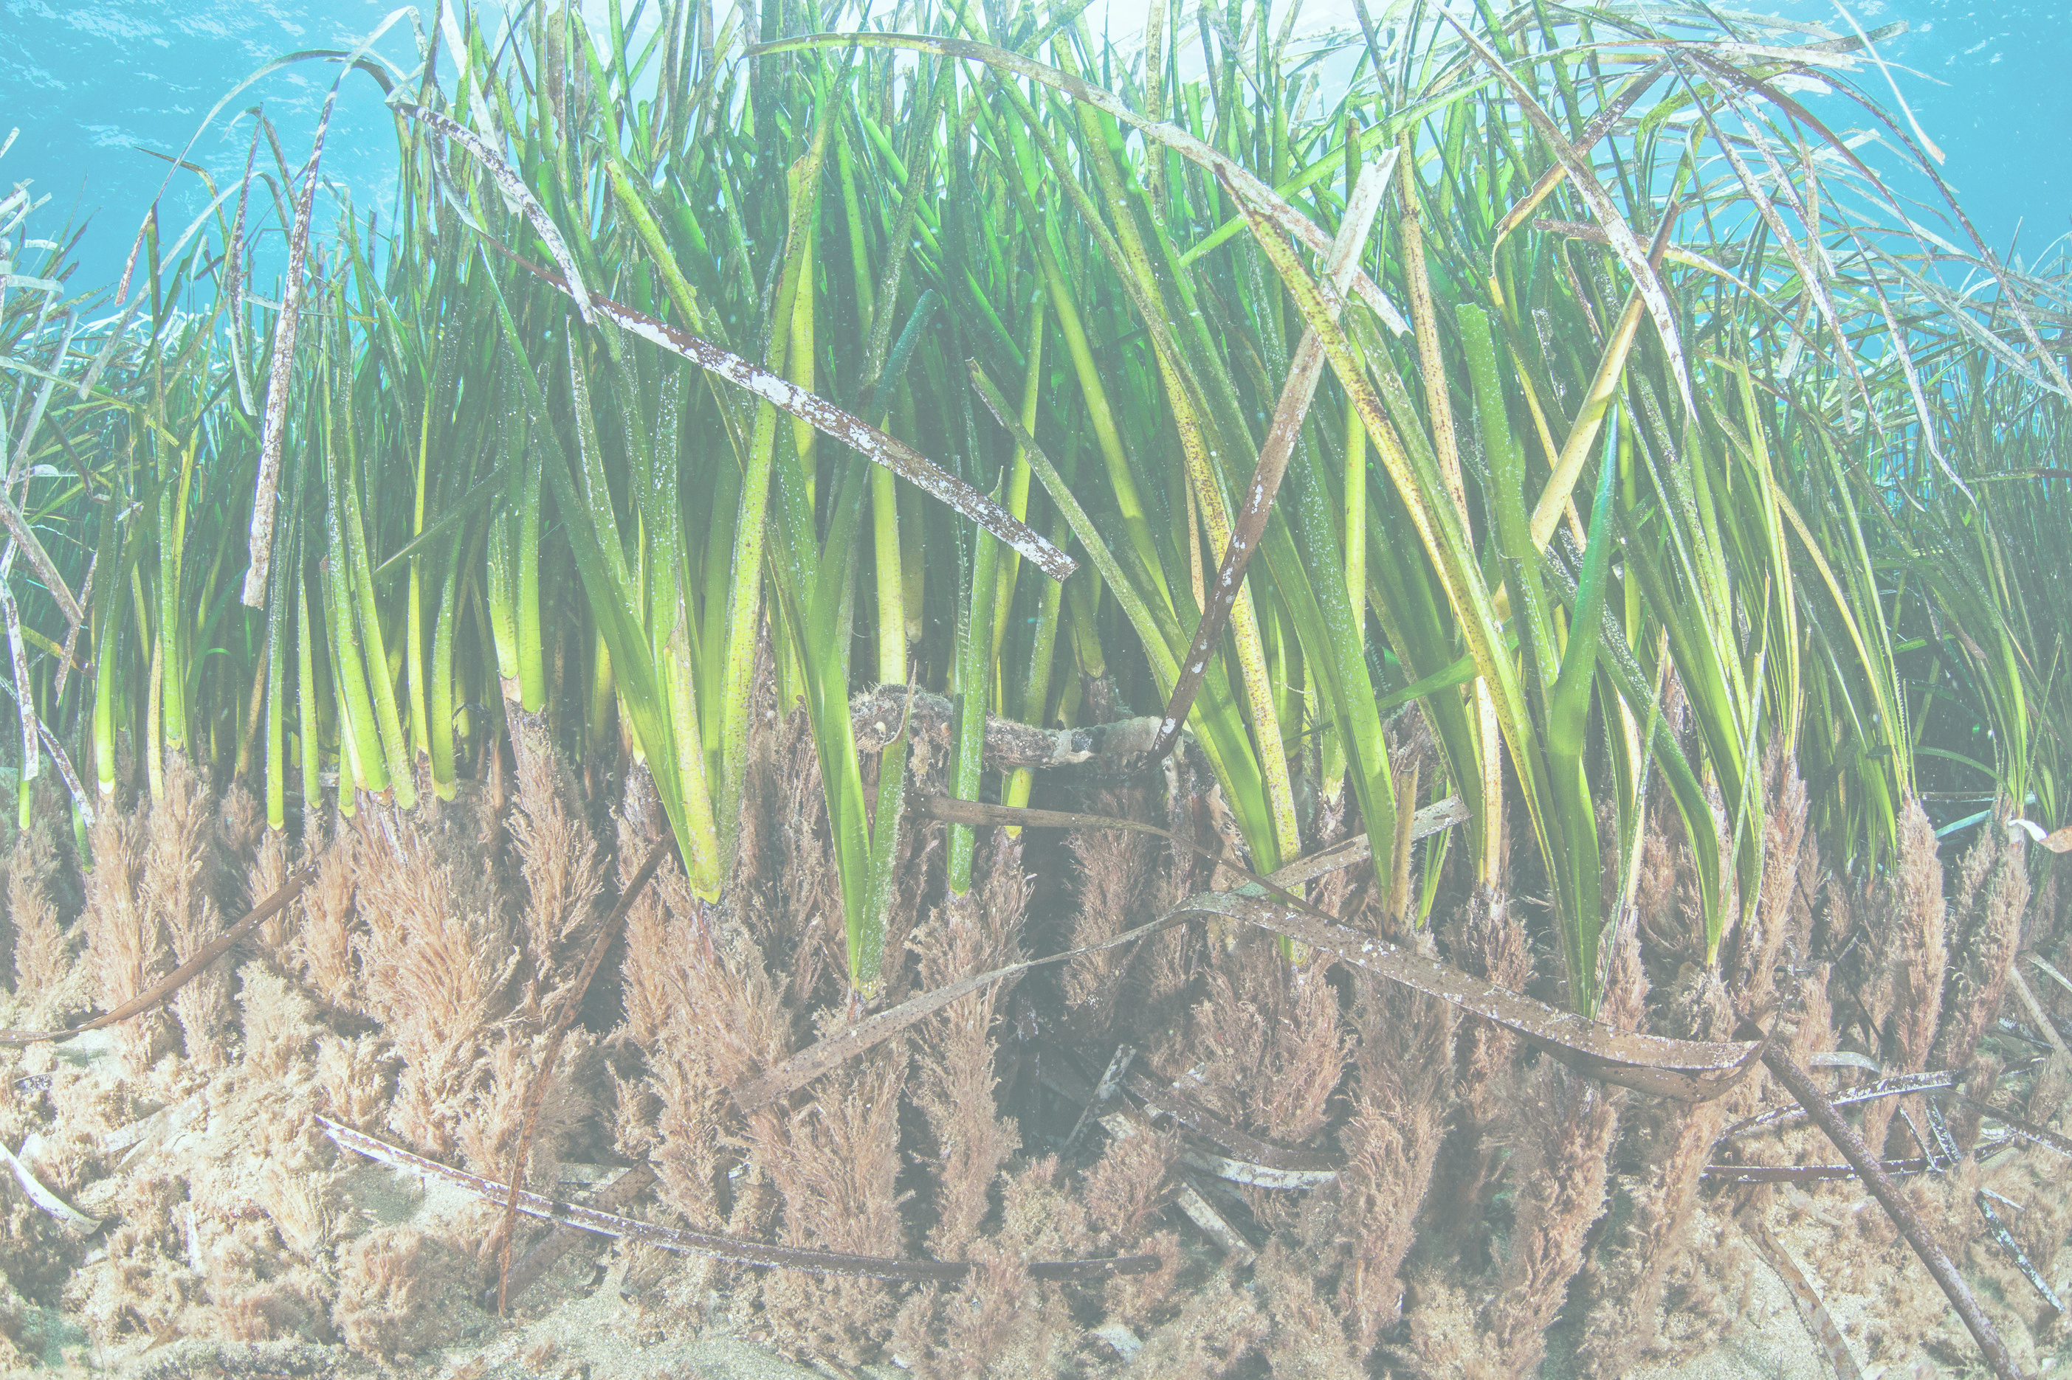
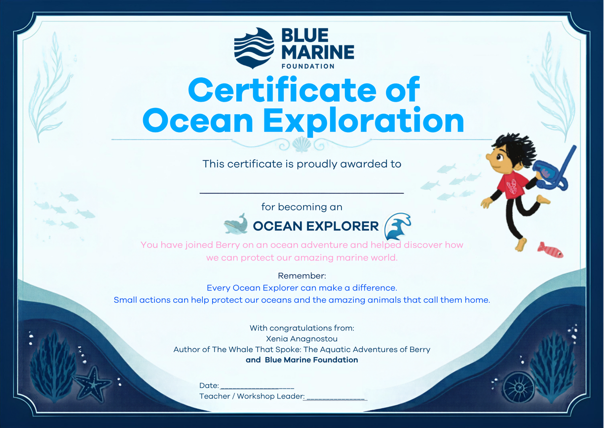
Congratulations on becoming an Ocean Explorer!
Notes:
(I like this- can design up separately on canva?)
lets give them awards/certificates for becoming an ocean explorer
resources
- paper, printer, scissors

Slide 10


Thank you

