Slide 1
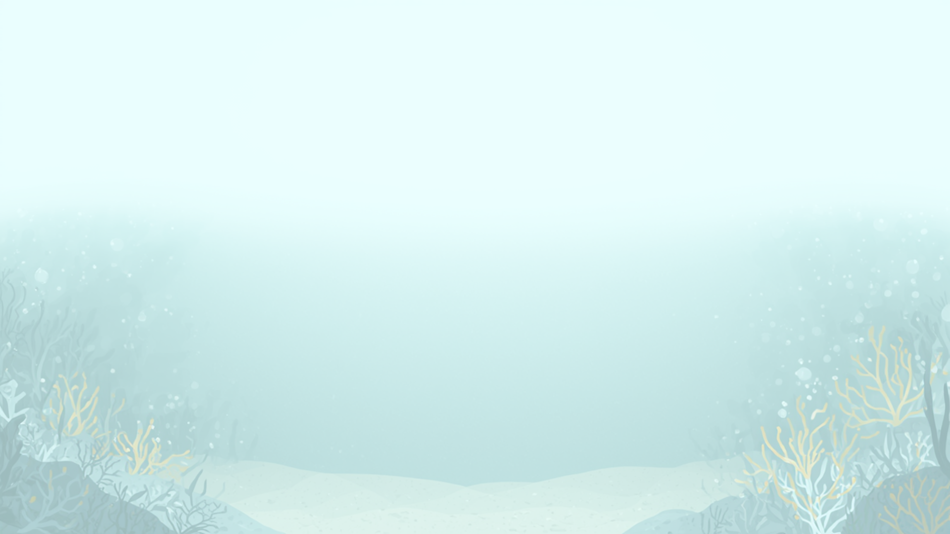

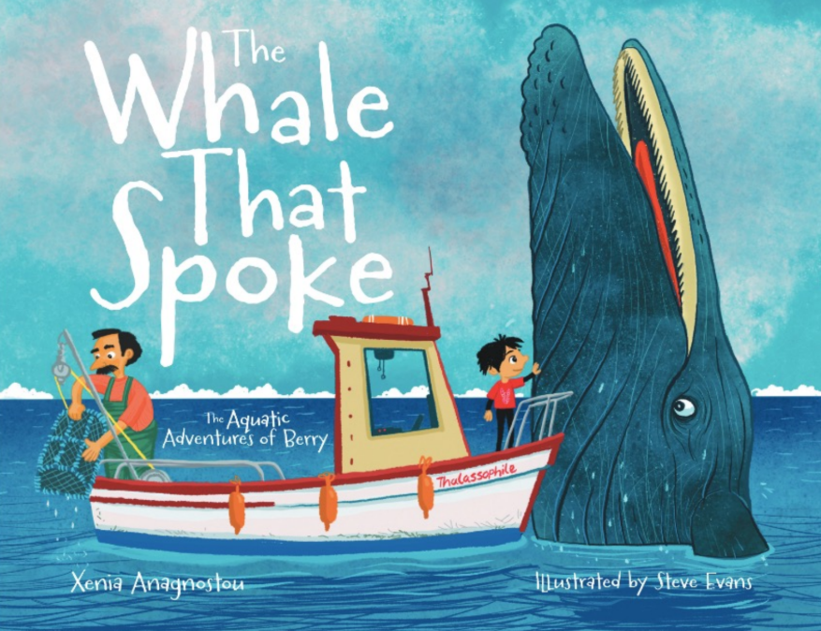

Ready for an Ocean Adventure?

Slide 2
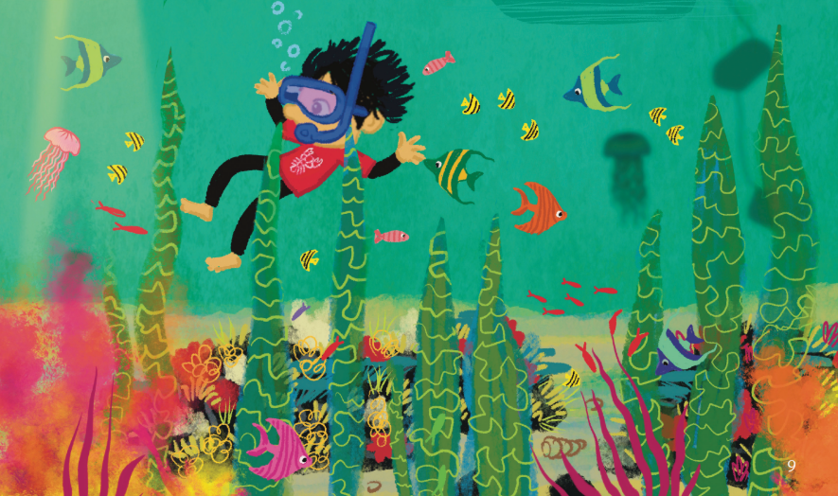
Learning Objectives
The ocean is home to a variety of different marine habitats and animals. These face many threats so need our help and protection.
I can...
1. Describe what a habitat is and explain why they are important.
2. Understand seagrass meadows as an important habitat.
3. Name the different animals found in these underwater habitats.
4. Understand the threats damaging marine habitats and the potential consequences to the creatures, including overfishing and pollution.
5. Learn ways people can protect and restore marine habitats.
  Understand what a MPA is and what it protects.
Notes:
Change image
Sep for year 1, 2 and 3

Slide 3

Curriculum links (KS1)
Science | Science
Living Things and Their Habitats | Recognise that living things live in habitats to which they are suited
Living Things and Their Habitats | Describe how habitats provide animals and plants with what they need to survive
Living Things and Their Habitats | Identify how environments can change and how this can affect living things
Working Scientifically | Working Scientifically
Students will make simple conclusions | Students will make simple conclusions
Students will communicate findings | Students will communicate findings
Students will discuss environmental problems and solutions | Students will discuss environmental problems and solutions
Geography | Geography
Human and Physical geography | Coastal environments and habitats
Human and Physical geography | Human impacts on environments
Human and Physical geography | Caring for and protecting environments
Human and Physical geography | Sustainability and conservation
Notes:
Edit this- to be hidden from lesson

Slide 4
Lesson overview
Section | Time | Summary | Additional Resources
Learning Objectives | 2-3 mins | Introduces ‘The Whale That Spoke’ book and the key content covered.
Meet Berry Intro | 2-3 mins | Children are introduced to the character of ‘Berry’ and the context of the book with either a puppet or short animation. | Puppet/ Animation
Listening to the book reading | 10 mins | Reading of ‘The Whale That Spoke’.
Activity | 20 mins | Short activity covering relevant themes from the book. Activity chosen dependent on the year group. | Dependent on the actvity- listed below each activity.
Plenary Worksheet | 10 mins | Short worksheet requiring pupils to engage with one key conservation theme covered in the book. Includes short written answers and multiple choice questions. | Worksheet Pen/Pencils.
Notes:
4

Slide 5
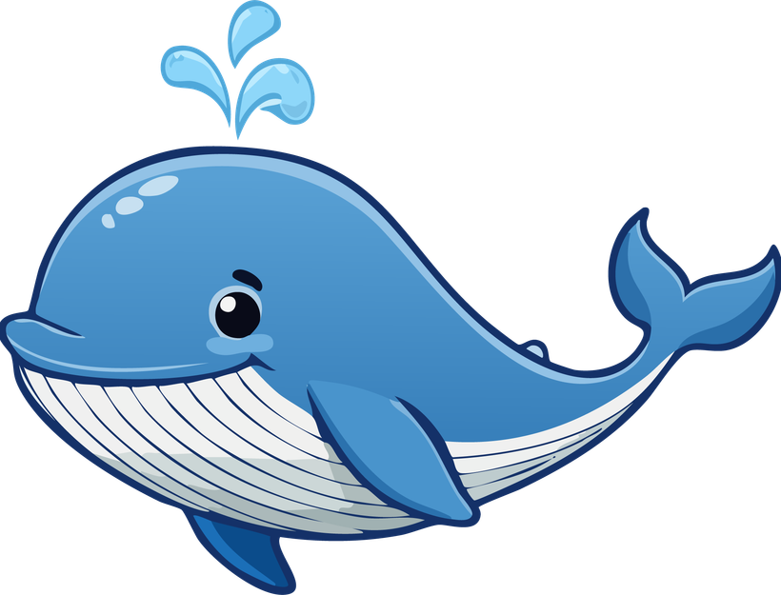

Introduction
Hello Ocean Explorers! 🌊
Today we are going on an ocean adventure with Berry
Let’s read Berry’s story and discover what happens to him and Nadia
Help Berry solve ocean challenges
Become Ocean Explorers
Xenia Anagnostou
Author of the Whale That Spoke
Blue Marine Foundation
Protecting the ocean and restoring marine life
Notes:
"Hello everyone! My name is Xenia, and I wrote the book The Whale That Spoke: The Aquatic Adventures of Berry.
Today, we're going to go on an ocean adventure with Berry. We're going to read his story, meet Nadia, and discover some of the challenges that animals in the ocean face.
But today isn't just about listening to a story. Berry is going to need your help!"
And we have some extra ocean helpers with us today! Blue Marine Foundation works to protect our oceans and help marine animals and their homes. They work with people around the world to make sure our oceans stay healthy for animals and for us.
"Today, we're going to learn about some of the things they work on, and you'll get to become Ocean Helpers yourselves."
"Are you ready to meet Berry and join his adventure?"

Slide 6
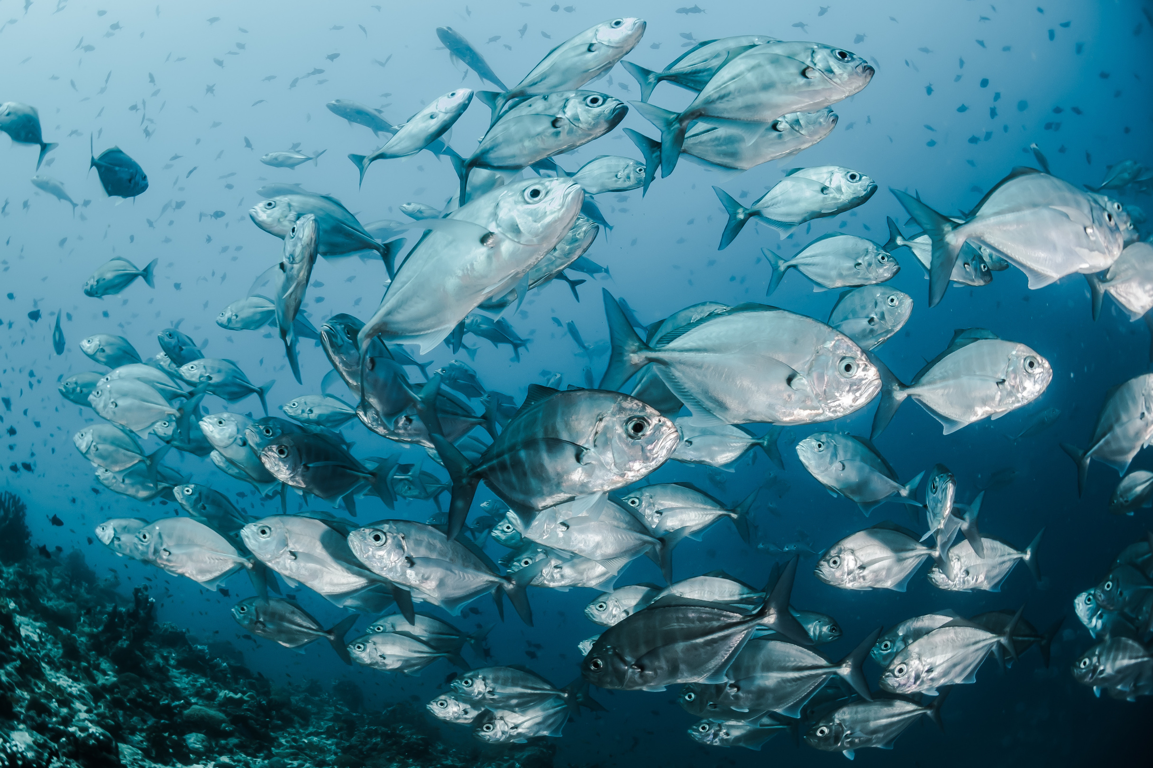
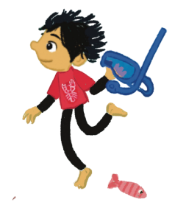

Let’s meet Berry
pictures, puppet, animation video
Hello everyone! My name is Berry.
I’m so happy you’re here because I’m about to take you on a very special ocean adventure.
When I met my friend Nadia the whale, she showed me just how amazing our ocean is, and how many wonderful creatures call it home. But she also helped me understand that our ocean needs our help.
My dad is a lobster fisherman. He loves the sea and wants to make sure there are plenty of whales, fish, lobsters and other sea creatures in our ocean for many years to come.
Nadia asked me to find some special Ocean Helpers, children who care about the sea and want to help protect it.
So, are you ready to join me, become Ocean Helpers and take on today’s ocean mission?
Let’s begin!
Notes:
should this come after the book reading? if not maybe need to reword slightly
Reword.

Slide 7
Mission One: Book Reading
Are you ready to discover Berry’s adventures and start your ocean journey ?.....
You know some of the problems that Nadia and her ocean friends face. But Berry doesn't just want to talk about the problems, he wants to find solutions! Are you ready to become Ocean Helpers and complete your first mission?
Notes:
lets think about more/different questions
hide the discussion questions.
1. What would you do if you were Berry?
We expect to hear:
-Help Nadia.
-Try to remove or report the danger.
-Tell other people about what is happening.
-Ask friends, teachers or adults to help.
-Find ways to protect the ocean and marine animals
2. Why is it important to protect the ocean?
We expect to hear:
- The ocean is home to many animals.
- Animals need a healthy ocean to survive.
- The ocean provides food and resources for people.
- We want animals and their habitats to be protected for the future.
- The ocean is an important part of our planet.
3. What are some dangers creatures in the ocean face?
We expect to hear:
- Plastic pollution and litter.
Fishing nets and entanglement.
- Overfishing.
- Damage to their habitats.
- Boats and other human activities.
- Losing places to feed, hide or raise their young.

Slide 8
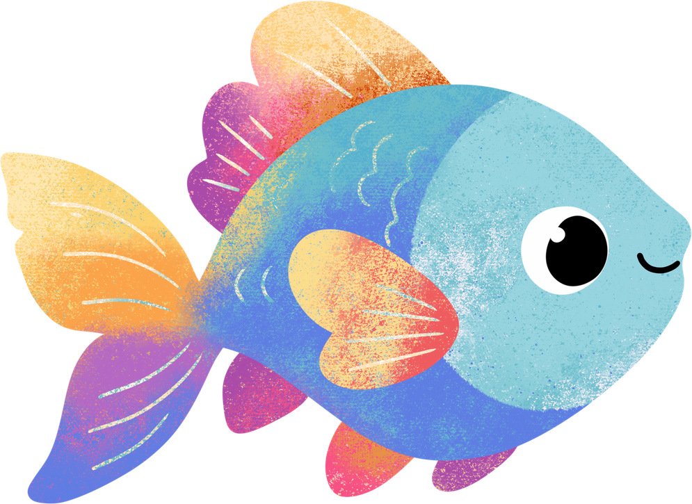
Activity 2-Year2
Build Nadia’s Safe Ocean
1) Who lives here?
Place the animals and plants in their habitats
Nadia-Fish-Crab-Lobster-Seagrass-Kelp-Reef
2) What happens when people use the ocean?
  Fishing
  Fishing nets
  Boats
  Pollution
3) Can you create a safe place?
Choose an area where marine life can be protects
What would you protect and why?
Notes:
"Berry has a mission for you. Nadia needs a safe place to live, but first we need to understand what is already living in our ocean."
Ask children to identify the different habitats and place the animals where they belong.
Then introduce the challenges:
Now imagine that people are using this part of the ocean. What might happen to the animals and their homes?
Children add the fishing boats, nets and pollution.
Then:
Can you choose an area that we could protect? What would you put there, and why?
After they have made their choices:
These kinds of protected areas are called Marine Protected Areas, or MPAs. They can help protect important habitats and marine life.
Discussion/ what do we expect to hear
1)Identify habitats:Seagrass meadows
Kelp forests
Rocky reefs
Sandy or muddy seabeds
Children identifying which animals are suited to different habitats
2)Why do animals need safe places? To find food
To hide from predators
To rest and shelter
To lay eggs / have babies
For young animals to grow
To avoid human activities that can damage their habitat
3)what might happen if an important habitat is damaged or disturbed?Animals may lose their homes
They may have less food or shelter
Young animals may have fewer places to grow
Some animals may have to move elsewhere
Populations could decrease
have the animals and the boats/nets/pollution cards mixed at first then create a "mpa", get them to separate them - tape off an area
Resources:
Large UK marine habitat board/mat (print a map and put it on a mat)
Nadia the whale (cardboard)
Fish cards
Crabs/lobsters and other crustaceans
Seagrass
Kelp
Reef/habitat cards
Fishing boat cards
Fishing net cards
Pollution cards
Optional: sticky tack
laminated cards? or 3D printed?
plenary: draw nadia in mpa, focus on importance of mpas
worksheets for each activity/year group

Slide 9
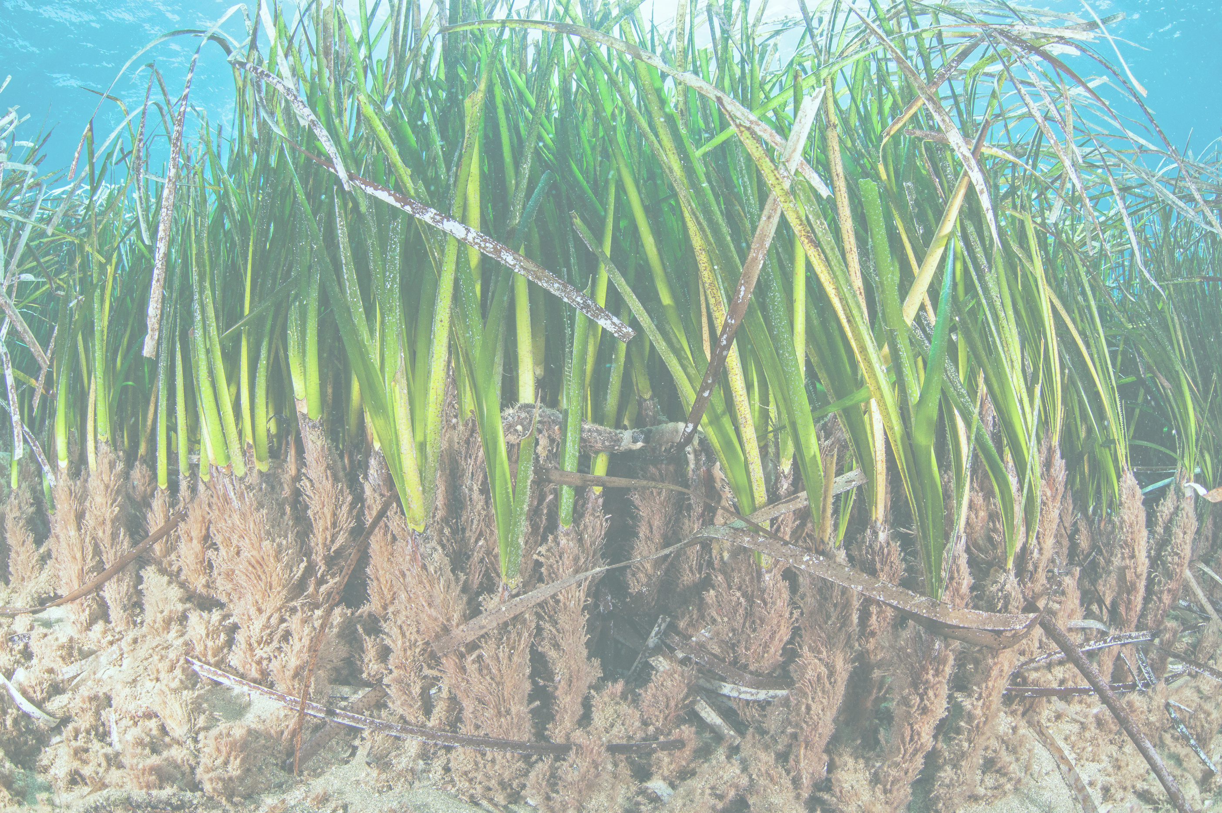
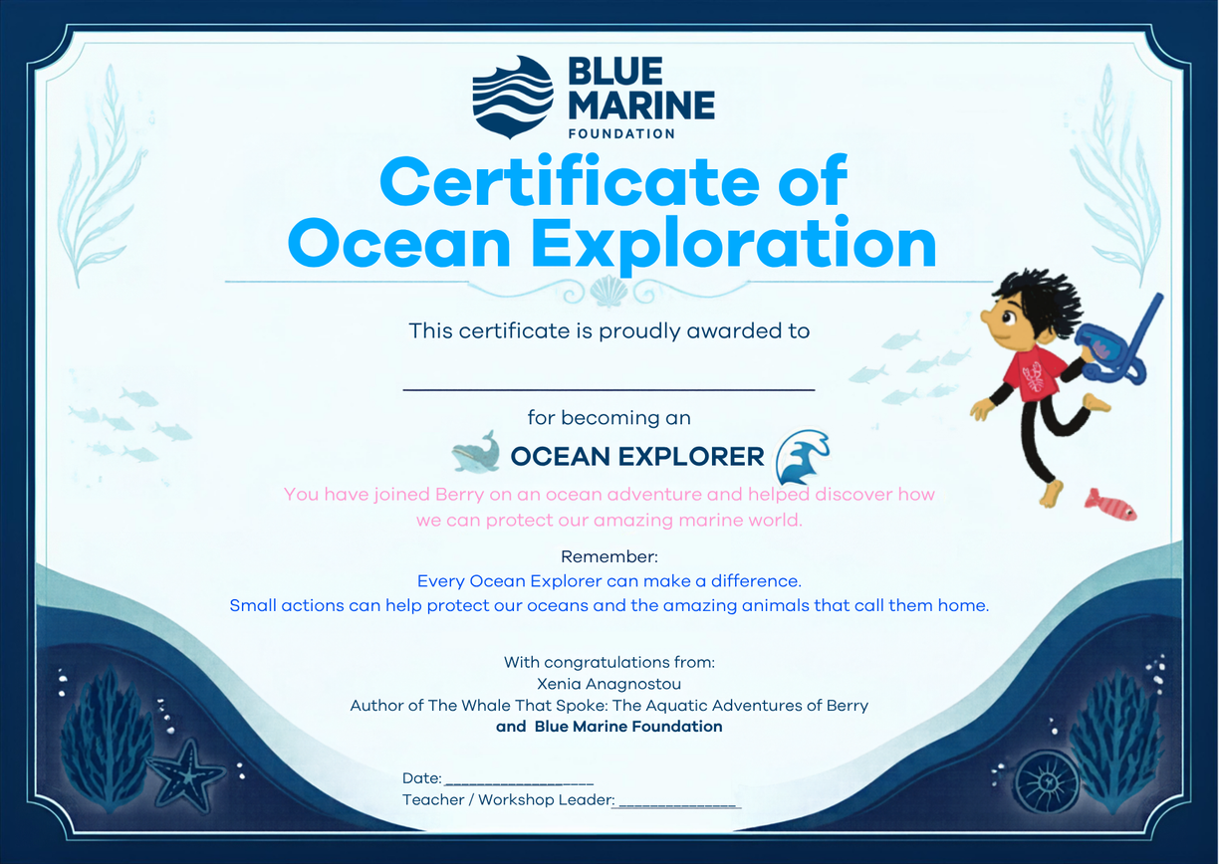
Congratulations on becoming an Ocean Explorer!
Notes:
(I like this- can design up separately on canva?)
lets give them awards/certificates for becoming an ocean explorer
resources
- paper, printer, scissors

Slide 10


Thank you

